Slide 2
RSC+

Slide 3
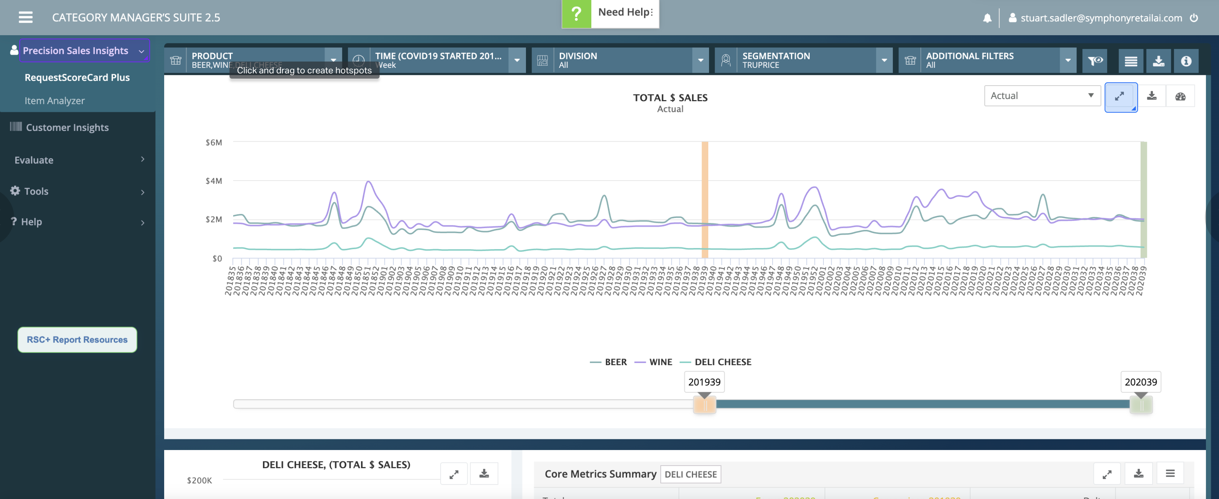

Slide 4
General design pattern comment: the filter label e.g. PRODUCT should be quieter than the selection e.g. Beer, Wine, Deli Cheese. Avoid all caps, at least for the data itself - the label may be ok but TOO LOUD. i find these icons are not helping - there is so much around the UI ink that it's very noisy. They may help if the overall level of ink for the UI controls is reduced.
Legends: 1) unless this is a well-understood industry format YYYYWW - I would suggest adding a space or something like YYYY WW 2) way too many timeline demarcations here. first off, only print the year every 52 weeks. this will help the user be able to see year long cycles at a glance. secondly, you probably dont need to print every single week value. every 4 weeks may be sufficient. the hover provides point in time values such that the legend probably does not need this. The legend is the noisiest/loudest thing on the page and least important relative to the data.
1) this looks like highcharts package to me so i know it is hard, but i like it when plot labels are right on the plot itself, not below. 2) some icons on the plot might be cool - a beer bottle; a stick of cheese - not just because it's fun but it helps the data stand out more clearly. 3) i dont really understand the need for the slider control here - seems like letting people just zoom on the appropriate region makes more sense. i like when the data range is in a dropdown with some pre-defined logical values based on user need (i.e. if "quarterly" is how users think about this, then that becomes a view by default -- even when there is always a custom date range option).
this plot takes up a lot of room, pushing down other content that may be more useful. consider compressing some whitespace or removing the slider (see other comments). It doesn't really draw any conclusions for me either or inform a decision that i can tell.

Slide 5
i cant see the whole chart, but if the idea here is "show tabular data and show chart viz on the same screen" that may be good, but i think it depends on the viz. in this case, you could probably have the bar charts be inside the table and totally remove the additional plot at left.
This section seems like it could give a helpful, plain-english summary. if you know they are comparing period 1 to 2, usually it is "how are we doing this year compared to our benchmark?" Imagine something like this at the top of the page, which could also be informed by data (i.e. you only call out "interesting" deltas such as "more than 10%" or "1+ deviations": "Summary: revenue is up 12% with volume 11% up. Another idea: a collection of small slope graphs here might provide more insight if the 52 week net change is more important than the journey (what happened along every single week between week 1 and week 52). Again: user research should be informing these visualization choices.
Product value question: "IS THIS A MEANINGFUL CHANGE?" i like "change" more than "delta" but for analysts, that may be ok. The point here is that if you want to be a data display product, this might be ok - but if you want to be an insights tool, then TELL ME WHAT DELTAS HERE ARE INTERESTING. I realize next-best-action is out of scope for this product (cinde?) but you should be able to calculate what meaningful change looks like for these metrics such that the UI can celebrate and push forward interesting metrics vs. noisy ones. Yes, it may mean putting a stake in the ground on behalf of all users. It may mean saying that "a .1 deviation in volume per HH is not considered interesting" in your product - even if to some users, it is. When you put the stake in the ground that says "anything greater than a .5x multiple in volume is interesting" then the UI can promote that info as being "interesting" to pay attention to. I am totally picking Volume per HH arbitrarily - the point is that remaining entirely neutral about the data you collect and can show does not connote strong product value -- unless your product vision is to be a "preparatory tool for excel exports." So, consider adding qualitative values to your data points so you can draw the UIs more intelligently and promote signal. I would NOT ask users to customize/input all these parameters themselves nor would I offer user or instance-level customization out of the gate.

Slide 6
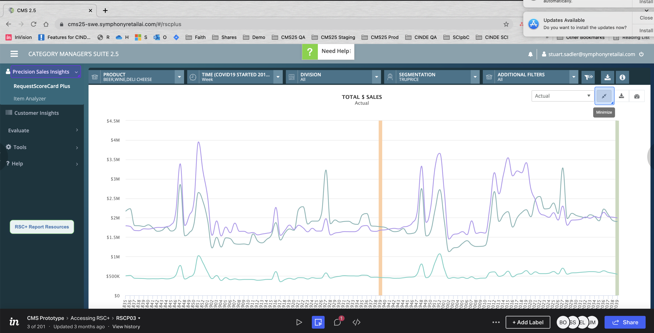

Slide 7
i see little use for this control. most charts esp. time charts are rendered larger than they need to be. My goal is always "shrink as far as you can"
See earlier comments re: date format for YYYYWW - consider those mask/formatter comments as being global for the entire app

Slide 8
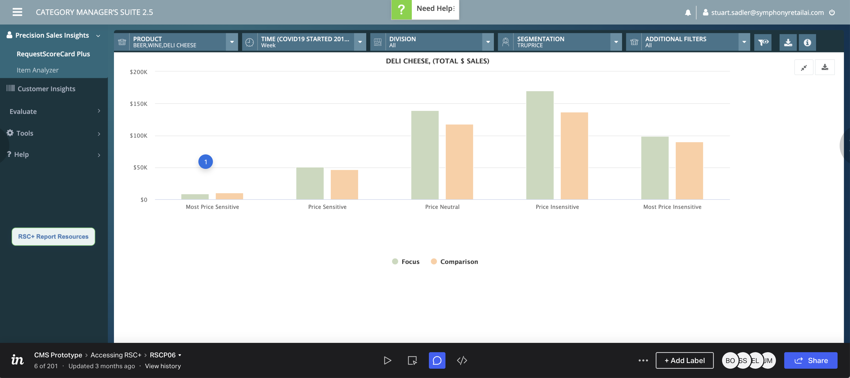

Slide 9
explore a slope graph here - if this is really about the delta between focus/comparison , then the line slopes are all that matter and will more strongly communicate the diffs. i don't care for how the legend does not say what the focus and comparison values are. general comment: consider using a color for the primary metric (focus) and make the comparison either light gray, or a low opacity version of the focus. i probably would opt for light gray. this makes the focus on the Focus and deltas, instead of making the two metrics visually equal as they are now.

Slide 10
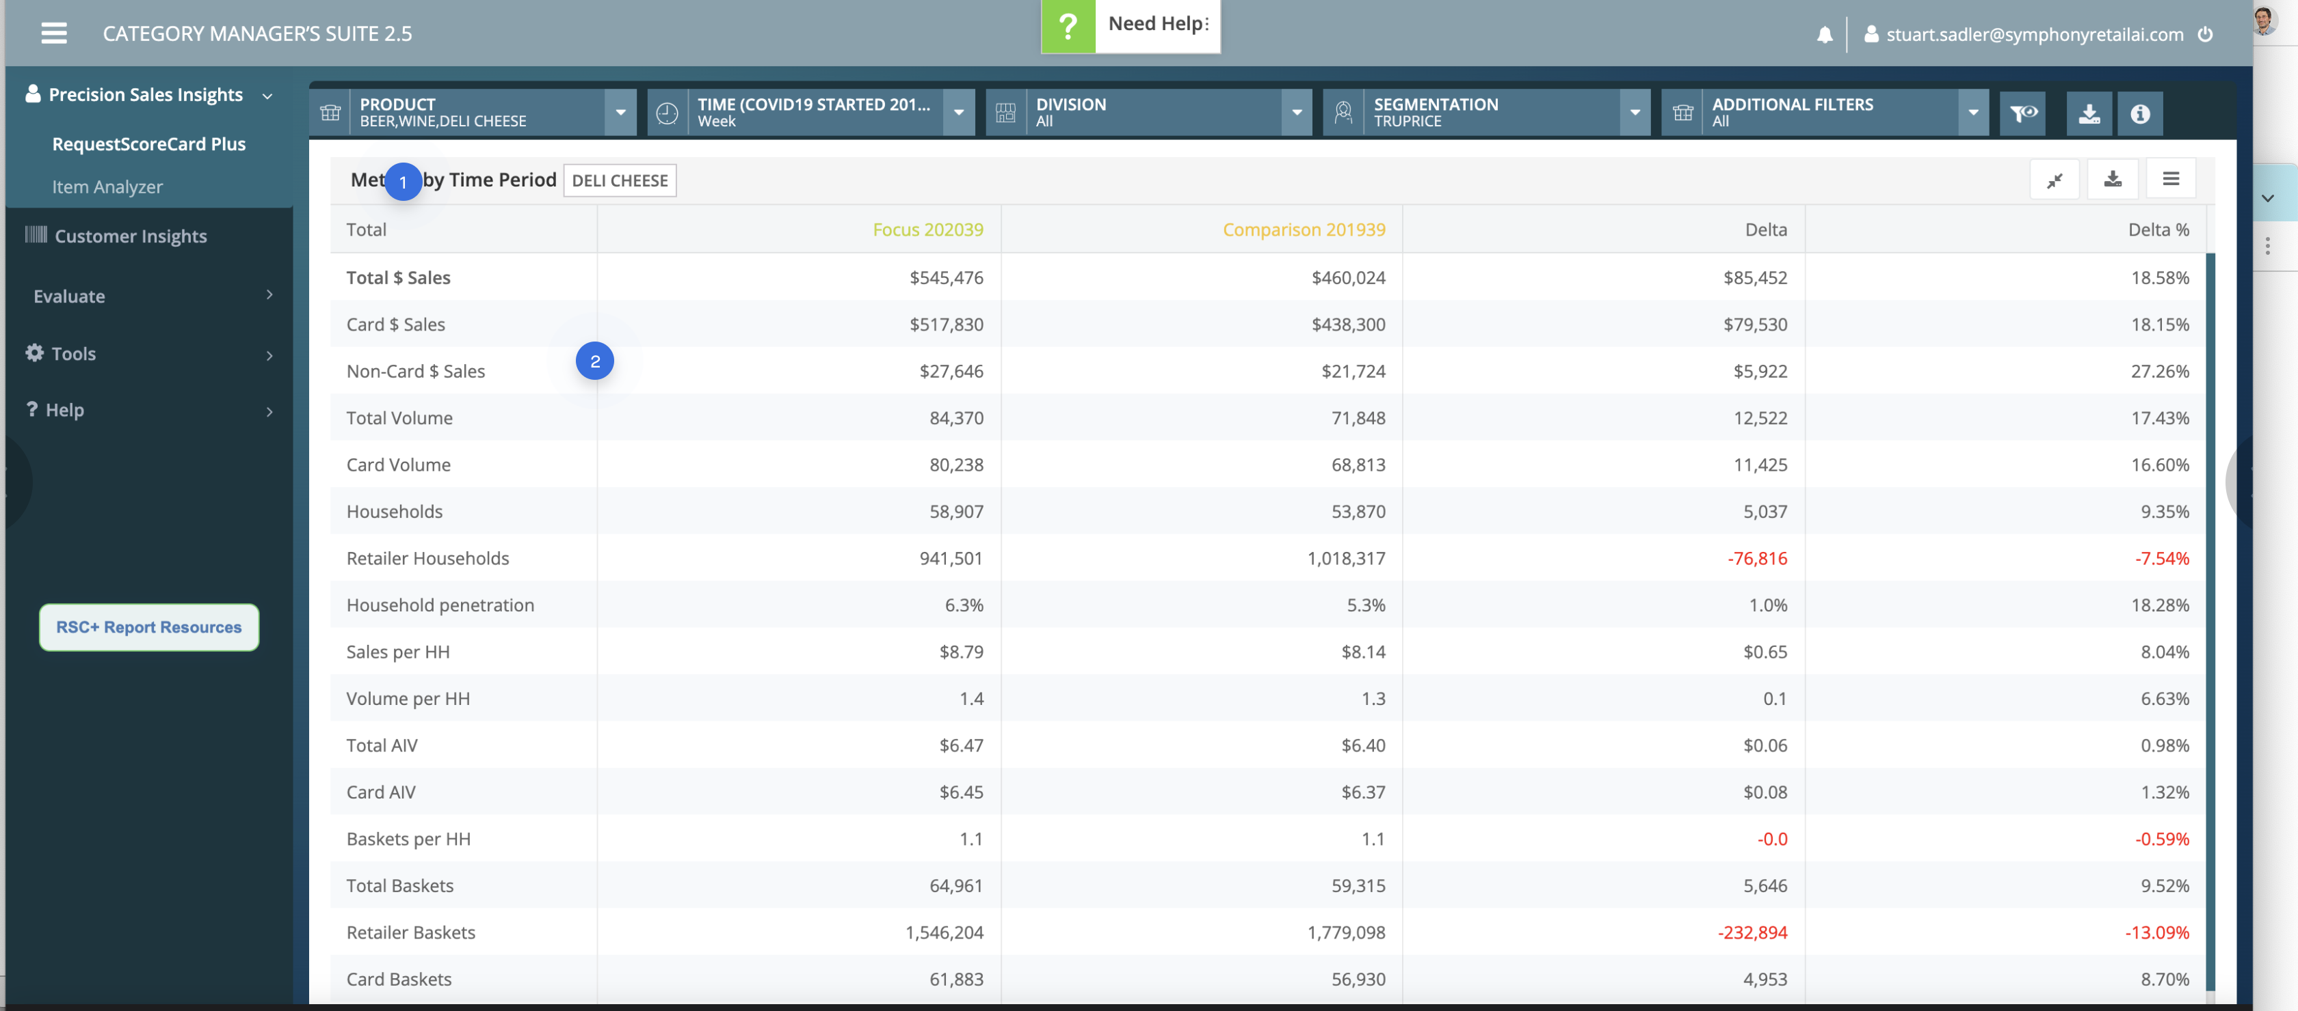

Slide 11
1) general comment about views like this: they basically support "find specific metric X" and don't do much else. this view does not promote any insight or tell me "what is interesting here?" Should it? that depends on the use case but it's just Evidence without any opinion or conclusion. 2) consider grouping the rows into sections or even separate tables so that you can add relevant visualizations to the table cells. for example "TOTALS" in one table or "HH Changes" in one table or "BASKET" metrics in one table. this allows things like percent-changes to be plotted with bar charts without indexing problems that cause small but important values to print way too small. Ex: if a 10-30% change is normal for metric A, and a 1% change is HUGE for some other metric B, and every metic is in one table with a "100% change" = to the 100% width of the <td> cell, then the problem is that metric B - when plotted with a visual bar in the delta % column - is always always going to visually look TINY even though the actual delta of 1% is really big/important to the user. As such, you don't want these metrics in the same group or table. That said, turning delta % into numbers + bars would help if done properly.
general rule - i like table width:auto more than width:100% - it really depends on context though, but there is a lot of white space and striping that is being visually activated here (all of which is noise).

Slide 12
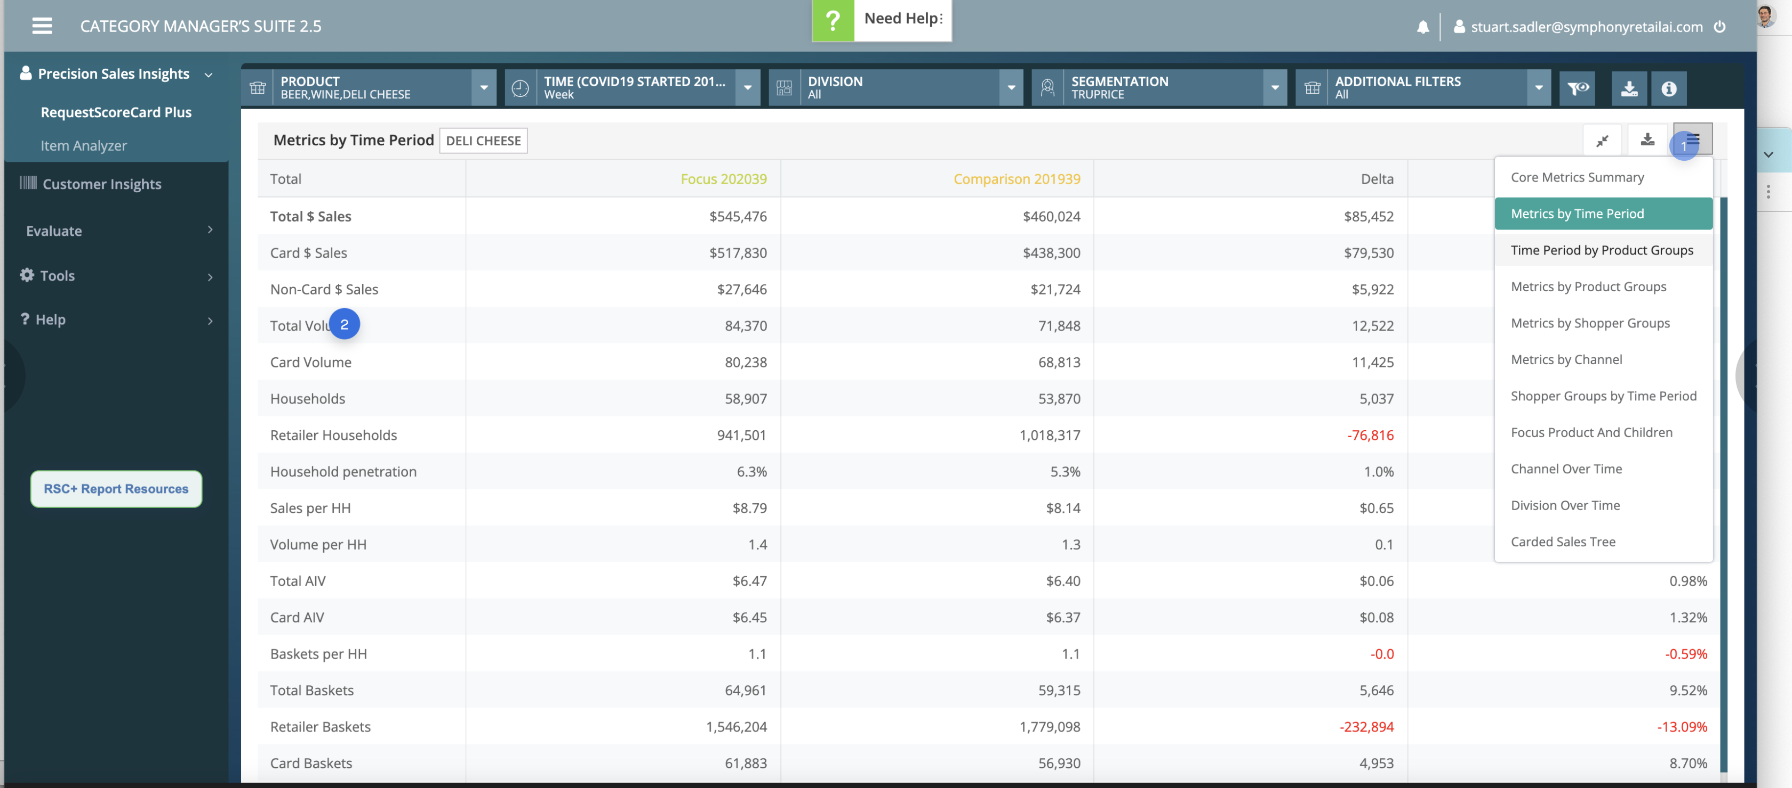

Slide 13
consider moving this control to left side, consolidating with the title of the table. i'd use a dropdown carat vs. hamburger icon as well probably. it's not "wrong/bad" per se, but it's a bit odd and would prevent us from repeating the same report title in two places.
Not saying to do this for sure, but small (i) icons next to metrics could be useful, particularly for custom indices, or whenever your system may have incomplete data. example: "Sales per HH is calculated as A+B but never includes C. Sample rate is weekly."

Slide 14
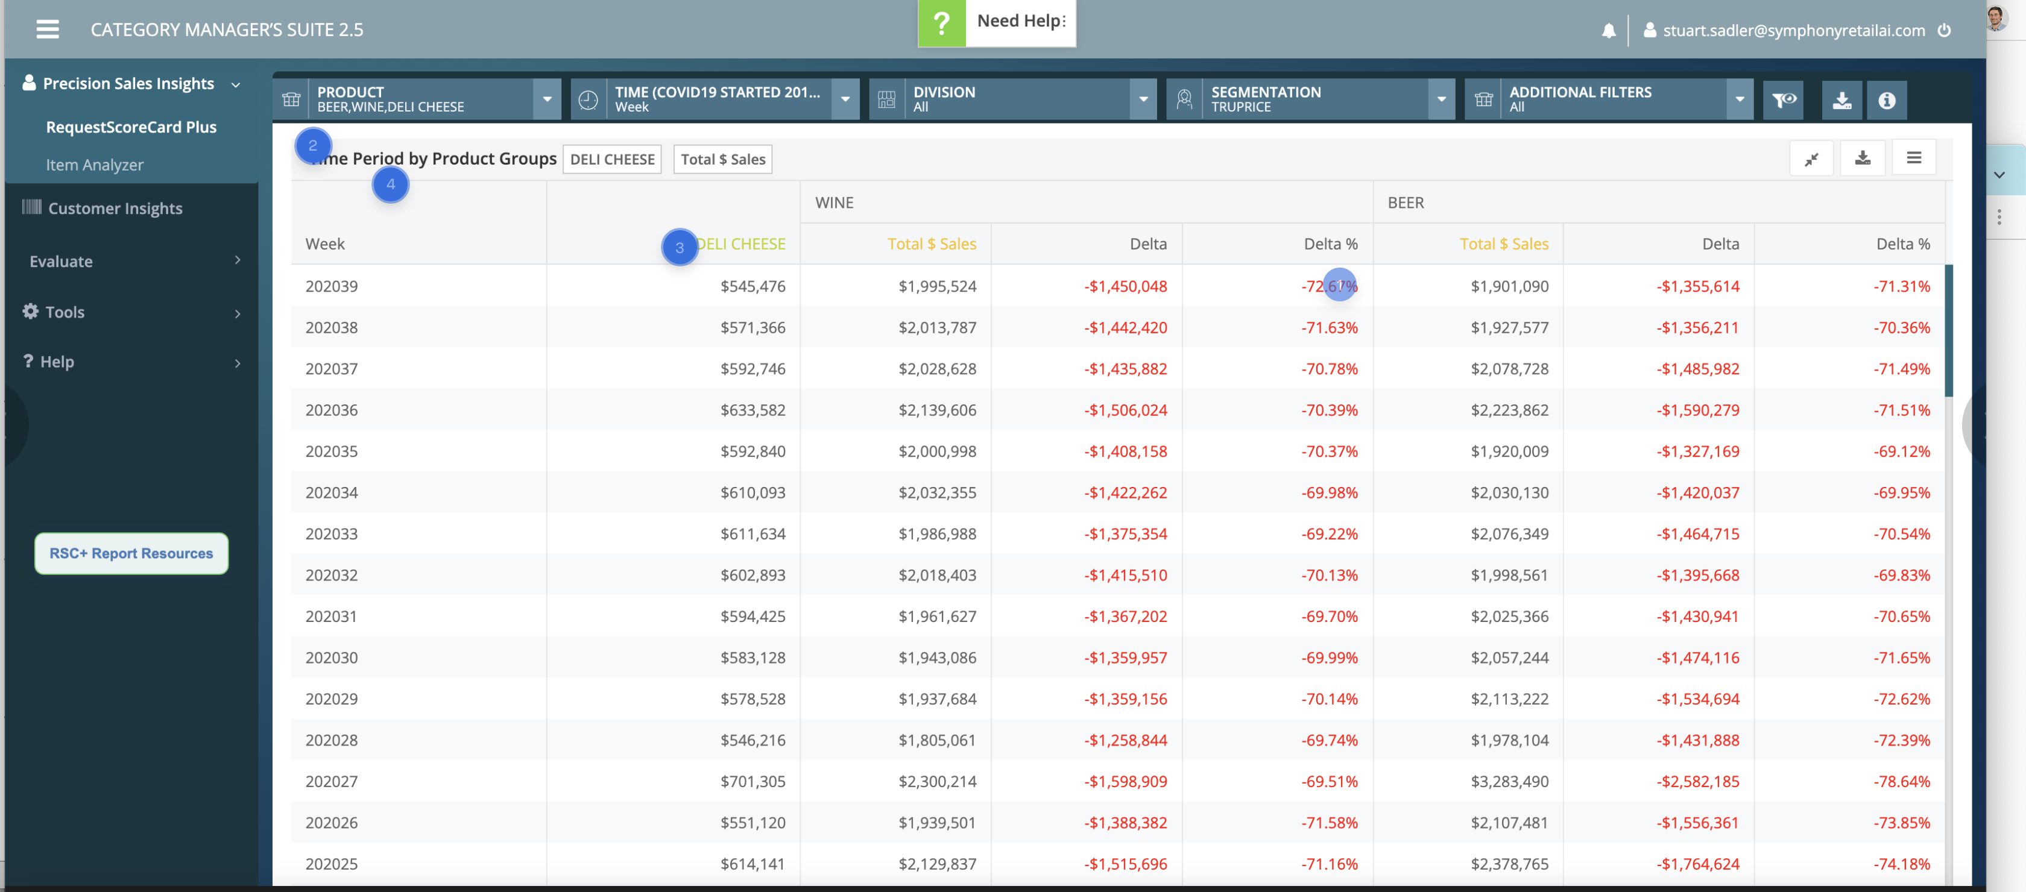

Slide 15
general question: is two decimals for % change really helpful?
Again, without a use case in mind as to why these comparison are useful, it is hard to judge the UI here. same comments on tables apply (striping issues, lack of visualization to indicate relevant change, etc). Depending on the use case, you might be able to 1) remove orange Total $ Sales columns (just show the delta value) 2) Consider a slope graph
all numbers: again, for export purposes, this level of precision may be helpful, but unless people are coming here for precise point in time values, reducing / abbreviating values like 1,262,291 ---> 1.3m or 1,262,291 ---> 1,260,000 May help with scannability. Be careful with K and M abbreviations particularly if sorting in a table structure since 138k 2m Visually - the top number looks bigger even though it is not.
One more final comment on the RSC stuff since it is the #1 most used report. The reason many customers are likely using excel on their own is because in general, the majority of these views are simply not going to be useful to most users unless they are doing "lookup a specific value" type tasks which is unlikely. Humans cannot process tabular data like this; so wherever you see massive tables with 3+ columns and tons of rows, it's usually a sign something is off - particularly if the values are primarily numeric. The data in this table views is screaming to be properly visualized - but doing that requires understanding specific use cases you wish to satisfy. The answer cannot be "anything/everything" - otherwise, you're building a tool as complex as MS Excel or Tableau. To me, the work here is understanding the most critical use cases and needs, and doubling down on the things you do well + the things users need most. It might mean that some use cases are not as well supported and you cant manipulate every view to support every use case - but the alternative is putting a tremendous burden on the users to get value.

Slide 16
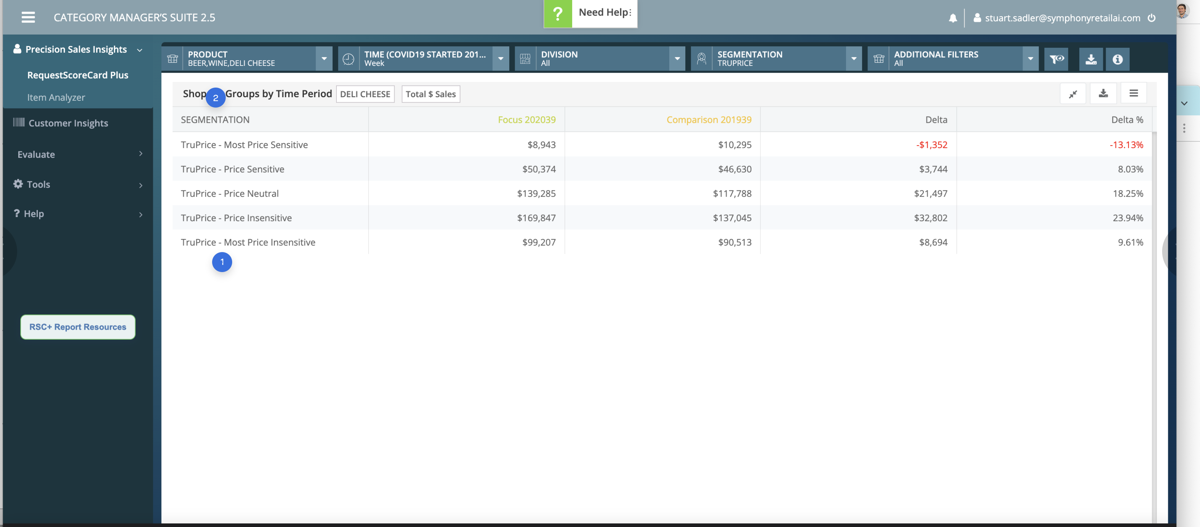

Slide 17
consider a visual here to connote this info. Remove "truprice" or put it in the column header (repetition in every cell is a signal that the text should be in the col header). These labels are long and hard to read when it is a simple scale. for example: $ = most price sensitive $$$$$ = least price sensitive -- or -- Most $ sensitive (replace word Price with $) -- or -- Change the column to look like this, beginning with the column header: << Least (Price Sensitivity) Most >> * * * * *
General UX comment: i would imagine the Use case here is something like "can / should i increase the price of deli cheese and if so, by how much?" The actual comparison of facts is not really the goal. They're trying to do something here: what is it? IT seems like a basic algo could be constructed that would give some general guidance here as to what to do with this data. As always, what is the job to be done? what is the precise decision they are trying to make? that should inform the design

Slide 18
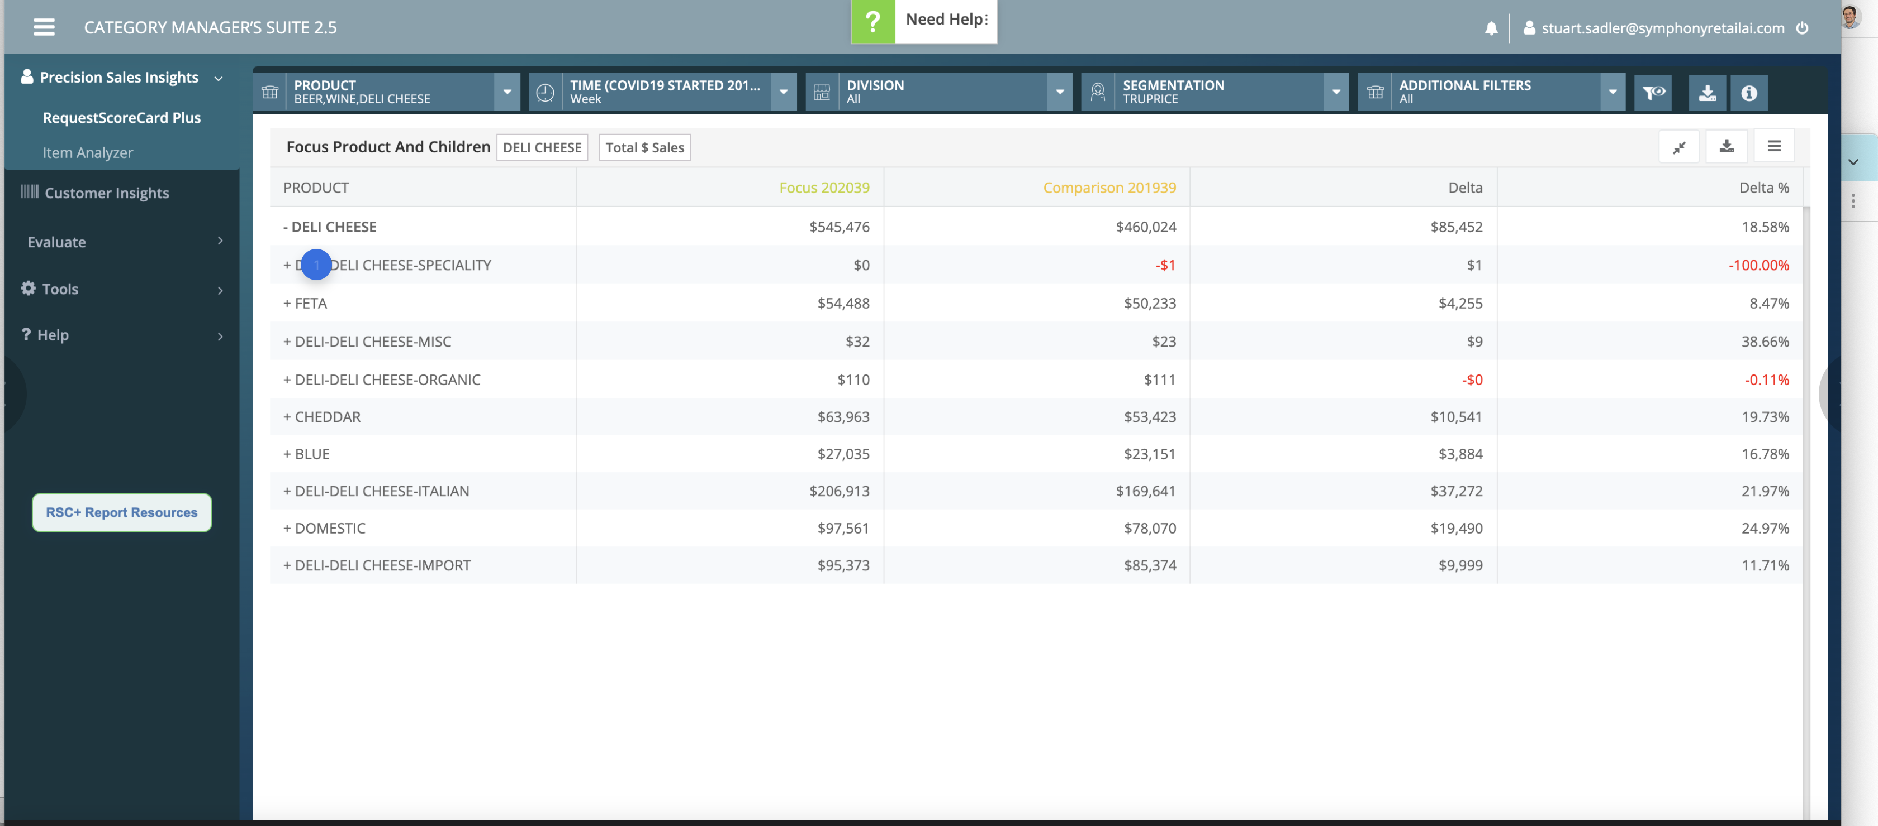

Slide 19
if the -+ is meant to indicate a parent/child relationship, i would remove these and just indent the children about 1EM or so. same affect without adding new ink or making people think about what +/- mean.

Slide 20
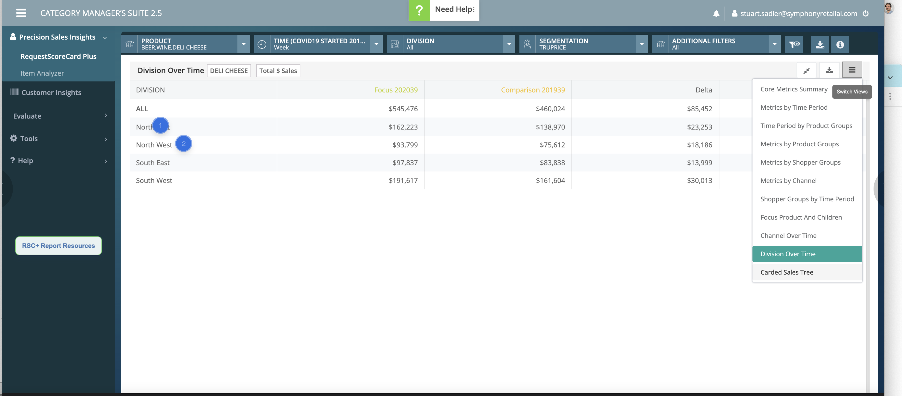

Slide 21
Grammar: at least in the US, these are one word, not two. (i.e. Southwest). @StuartSadler may not like some 'Merikken suggesting English corrections ;-)
If this division is standard in the product (i.e. I cannot create a 5th zone like "central") it might be interesting to plot these as 4 separate tables over a 2x2 matrix so "southwest" for example is in the "bottom left." Secondly, I wondered if this is or should be indexed like per capita where we create a fair baseline to make comparisons. In short, is it fair to compare Albertsons in Northeast US (non-existent brand in Massachusetts) to Southwest US (I grew up with one 12 blocks away in Phoenix, AZ). The table suggests that the goal is comparison but is it apples to apples?

Slide 22
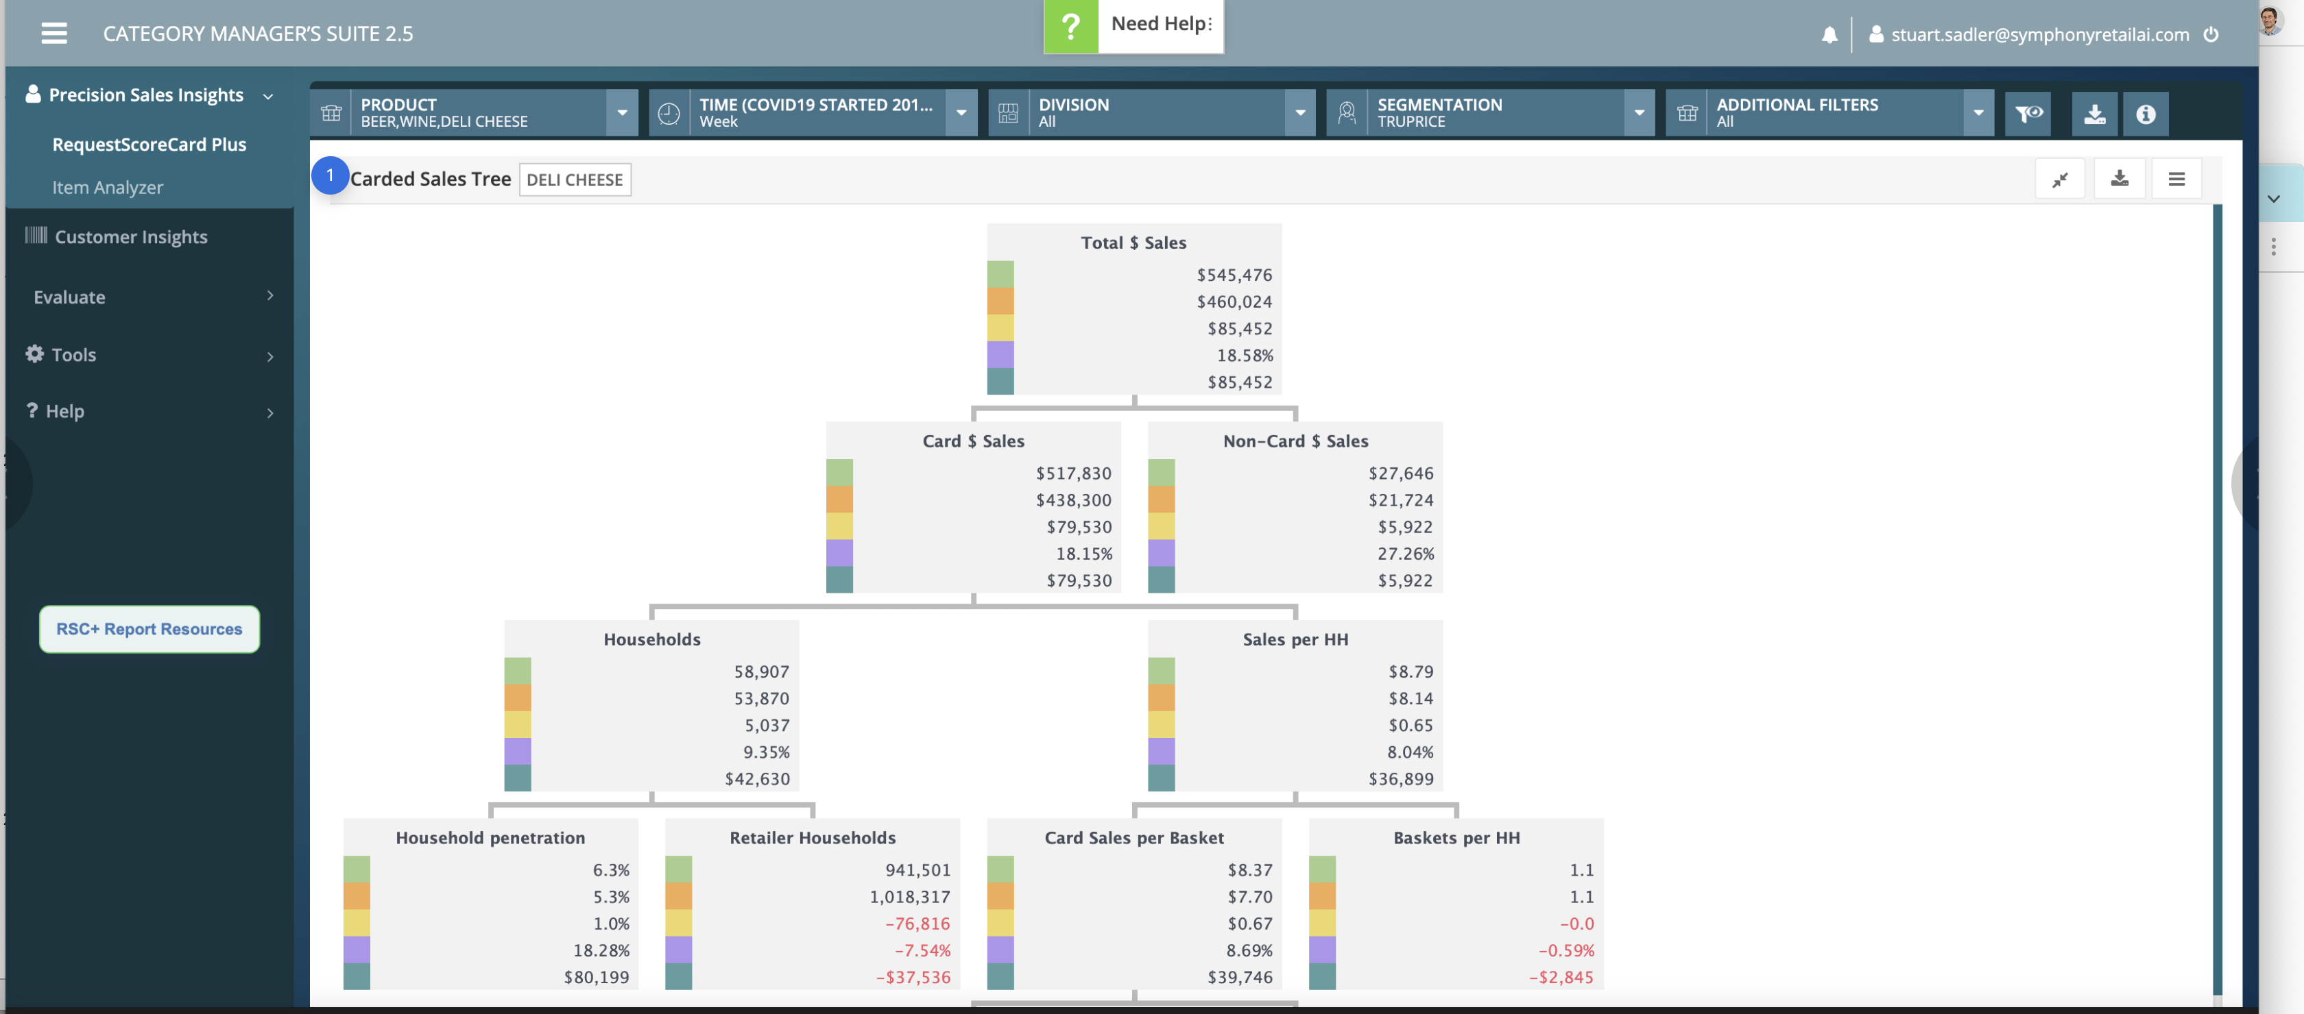

Slide 23
I dont know what business question or use case this really answers. The color squares don't add any insight or value that I can see and suggest correlations when there aren't any <?> I imagine that there are key "as compared to what?" questions this could answer. It also seems that relevant comparisons that could be visualized that are not. Ex: non-card vs. card sales: the UI suggests that there is a natural comparison to be made however, the actual data for each bucket is not visualized to be easily comparable. So, again: what is the key business decision that is being made and what's the workflow for that? This needs to inform visualization choices.

Slide 24
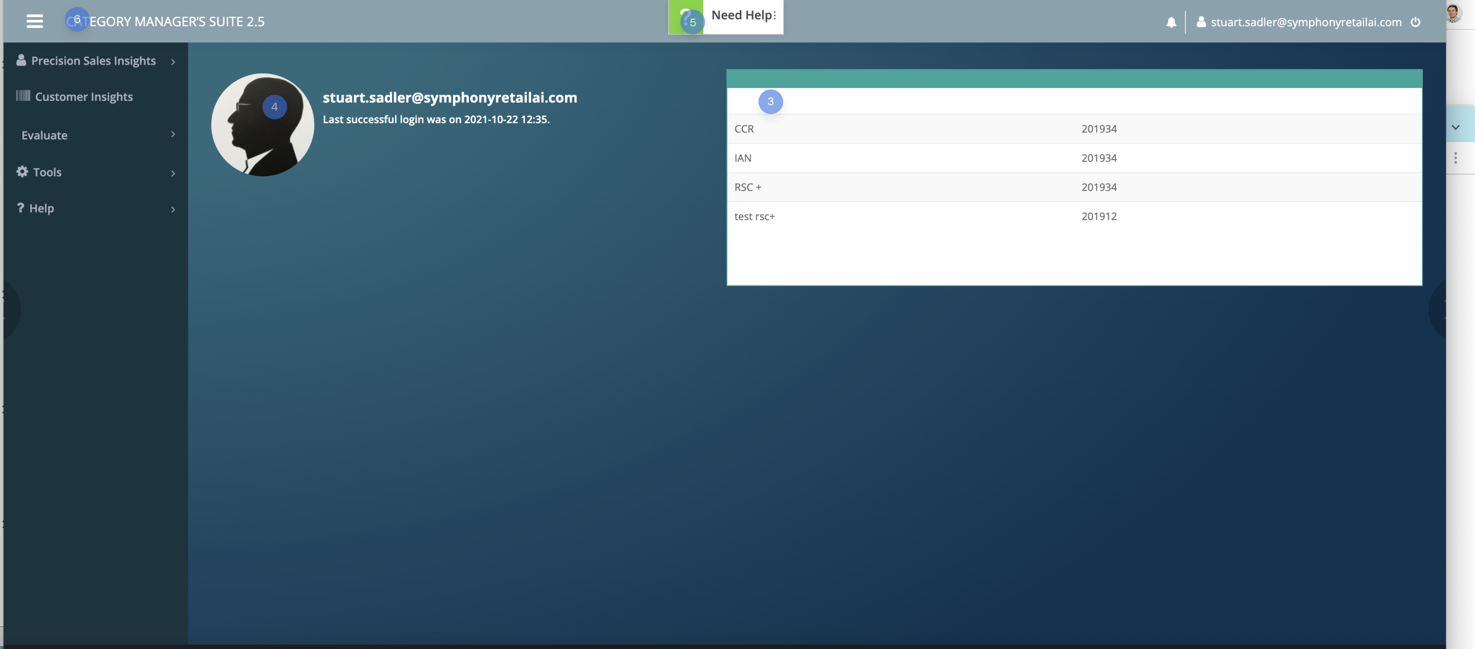

Slide 25
Hi: this dashboard serves very little purpose to me - in fact, I would guess most people have no idea what the one table of content at right even means. Dashboards should have a stance/opinion; never blank. Most data products like this should be focused on things like: 1) facilitating high frequency user tasks (make it easy to do common things right form here) 2) surface insights: insights can be many here - but if users are "subscribed" to key reports, then they have already expressed a level of interest. with this data, the system should be able to surface insights. Things like irregular/unusual movement/activity (meaningful deviation). Watchlists (i.e. if I am running a sales campaign, might i want to monitor its progress, perhaps against a benchmark?). Comparisons to competitor/self/time periods can also be useful. Leaderboards (be careful with this one - they can become static and meaningless). These are tactics - the decisions on which ones make sense to use here should be derived from the overall product strategy and top user needs. At one point I was told that we think users shouldn't need to go into excel - and that the product should provide "more value" -> what is that value? This is a good place to consider expressing it.
no idea what these numbers are or what this table is solving for me as a user.
Remove - this provides no value to me as a user that I can think of.
This is so loud, it suggests "this product is hard to use so we made the Help affordance huge." It feels out of place - typically this would be under an account/utility menu. Ultimately, we should strive to not need this at all.
Minor: consider making this say something like CMS > %company.name% - this is especially true if any users may be accessing multiple instances of CMS (I dont think that's a use case but if it is, this helps tell the user "I'm in the right place")

Slide 26
General template/UI comments: the giant blue/green gradients and palette feel dated to me and very heavy. This visual heaviness probably contributes to the overall slow performance feel of the application (actual latency in the query returns). You don't need a dark mode IMHO - just consider reducing this to more of a "white/gray" type application to lighten it up and get my eye off of the non-data ink. There is so much of it especially on these "thin pages"
Footer is a better place to put version number (2.5 etc.). Consider linking this to release notes/"whats new."
Login UX: I am unable to reproduce the login/auth screens - but one minor thing - I don't think I remember realizing that you were using MSFT to authenticate. If I recall, I had to "figure that out" (i.e. wasnt sure what password to use). If you can put UI screen captures in Invision, I can review. this is probably minor.

Slide 27
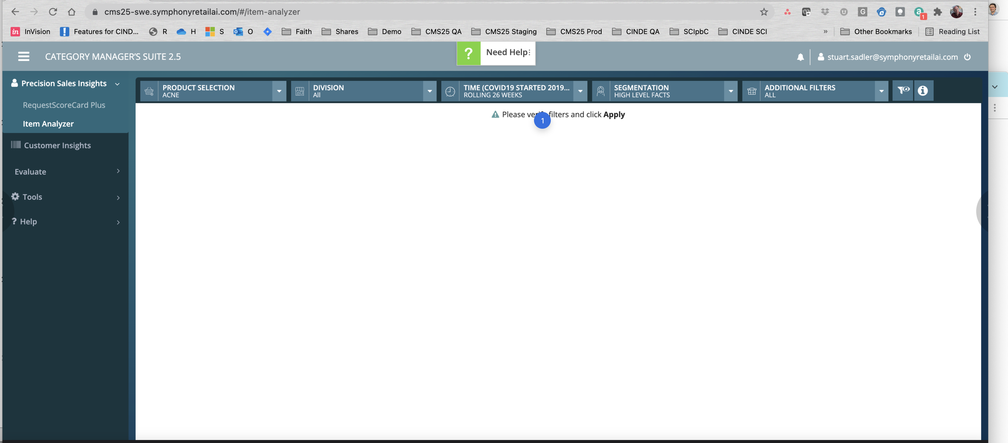

Slide 28
This has been mentioned before, but there is certainly a better default for this screen than an empty state. This is a wasted opportunity to push value at users that they may not know exists in the product, as well as support return/high-frequency tasks, tracking projects, etc. This theme has been discussed in other areas of the product but I thought it relevant to re-iterate again.

Slide 29
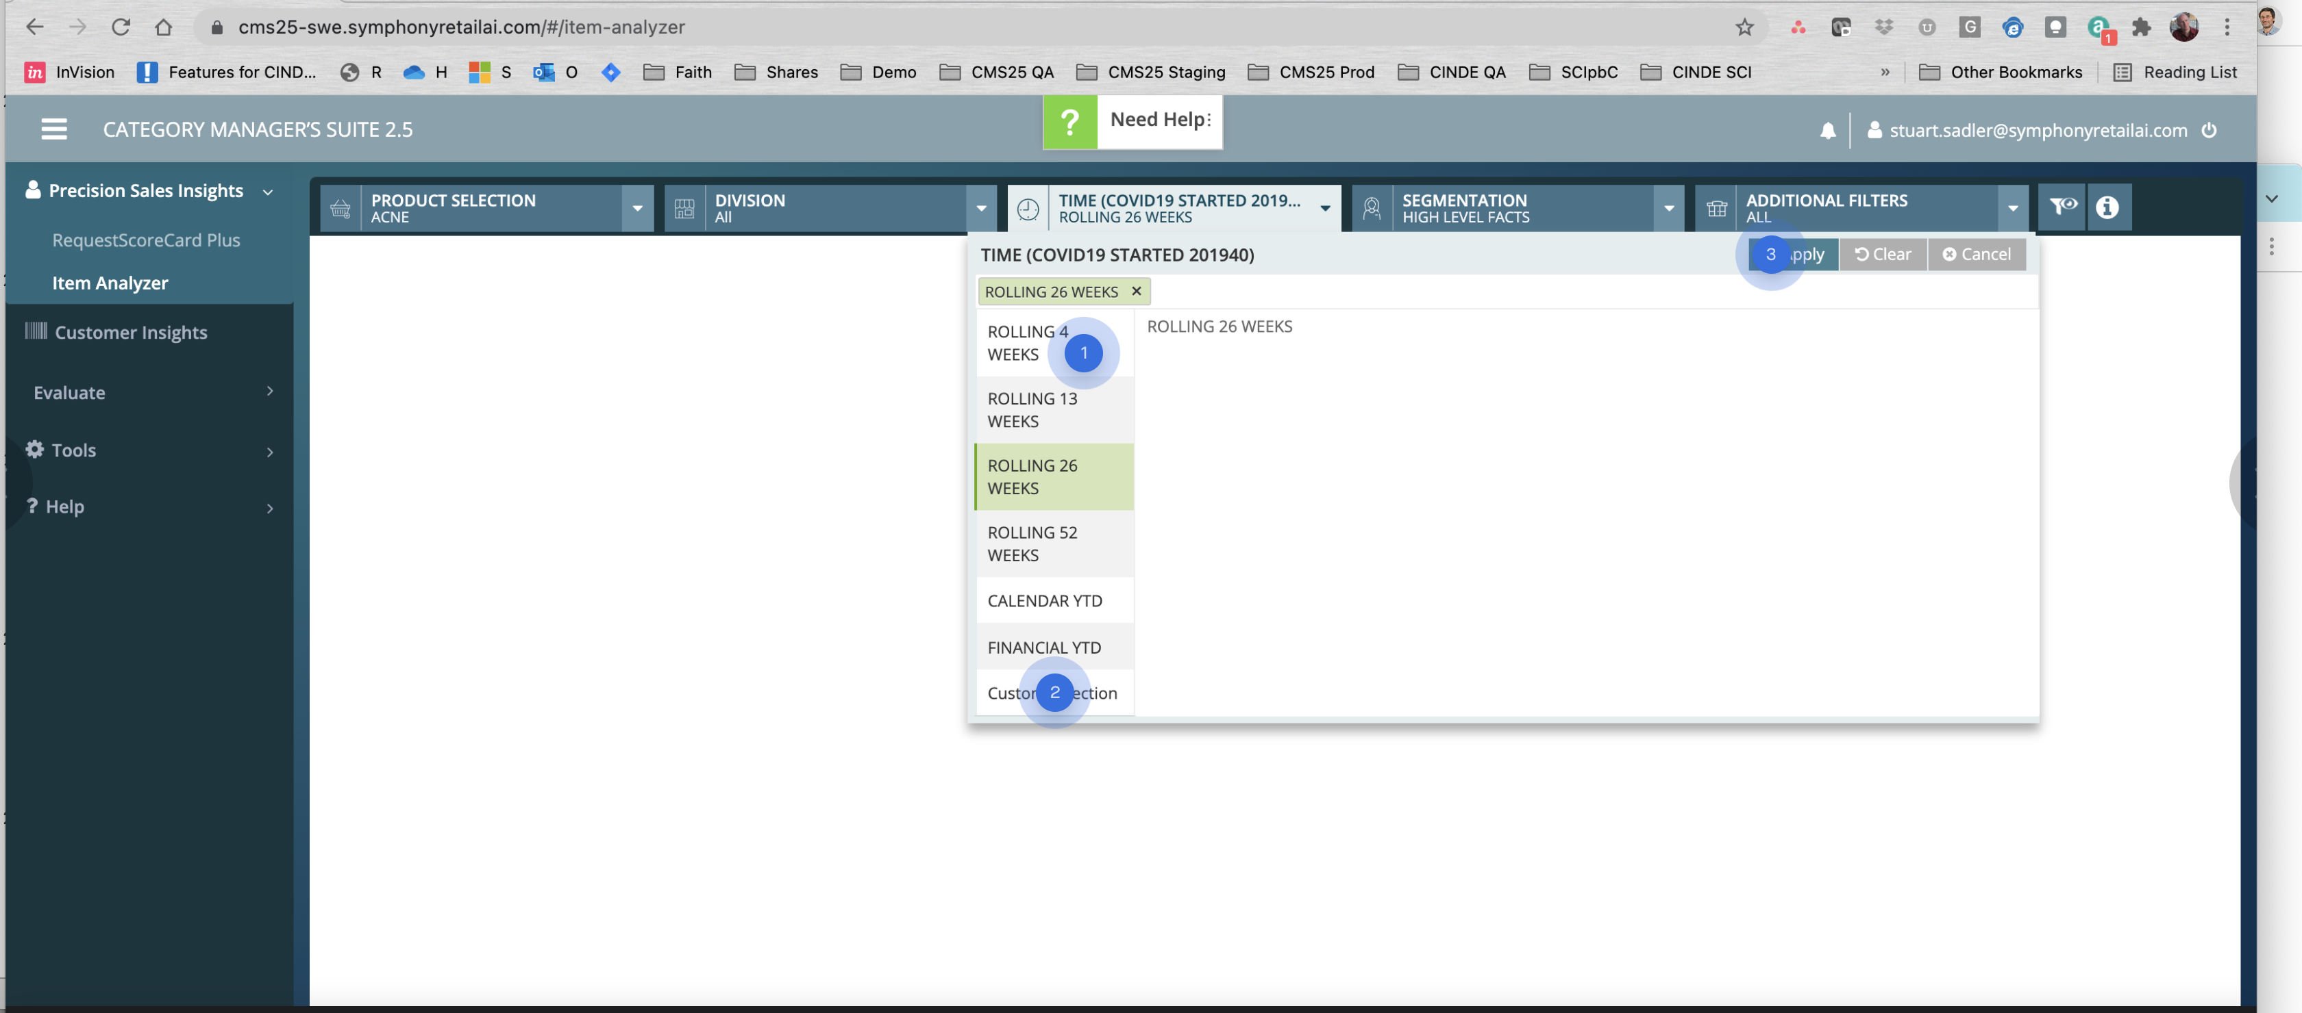

Slide 30
if this is a standard picker-UI, it seems unusually complex. Am I just selecting an item from a dropdown? why so much GUI for this?
I like "Custom Dates..." better
General Design pattern for these dialogs: 1) remove the checkbox and just have "apply" - it feels like it's another control and not decoration and it does not add clarity. 2) unless there can be more than say 10 "pill" selections on average in here ("rolling 26 weeks" = a pill), I would probably remove the CLEAR option entirely. let them clear one at a time. This could be wrong if there is high frequency use of this UI in sequence, with users regularly switching out option/selections from previous collections. I kinda doubt it from what I know. 3) make "clear" affordance quieter - maybe not even a button - and maybe park it lower on the <div> that holds the green selected Pills. 4) cancel - just use an "X" in the top right of the dialog. don't need "cancel" most likely. Overall goall: make the primary choice (APPLY) stand out through reduction of noise.

Slide 31
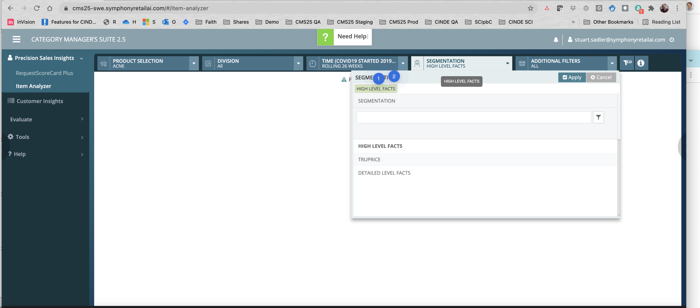

Slide 32
This could be a domain knowledge issues on my part, but I tend to think of Segmentation having to do with groups/cohorts of people/users/customers. "high level facts" sounds like something else to me. I feel like I'm supposed to be choosing a group of people here (a subsection of all Customers) but instead, it seems like you're asking me "by what feature in our product do you want to break down the current segment" -- the latter of which feels undefined to me (if it's not defined here and "high level facts" is not a group of people). In short, there is a lot of "thinking" required to grok this to me; it's not intuitive at first glance.
LOOK AT HOW MANY WORDS ARE IN SMALL CAPS IN THIS DIALOG. ;-) Basically, everything except the buttons. Designers need to do a careful review of where SMALL CAPS are used. I sometimes use them and they're not always bad (in particular, I like them for small/quiet headings) but in general, it really slows down reading/scanning to have so many words in small caps. I realize some antiquated ERP/backends store data in ALL CAPS and it's hard - i might even argue it is worth down-casing all the product catalog in favor of legibility if you cannot properly case words.

Slide 33
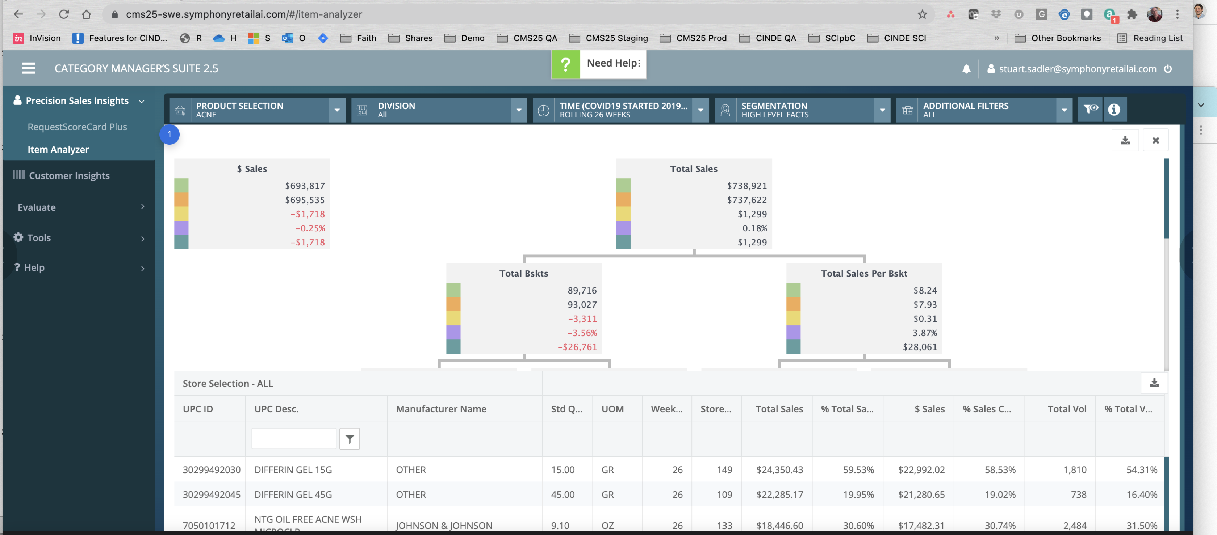

Slide 34
Candidly, this feels like an engineer built this as a POC - double vertical sliders; overlapping grid+tree diagram etc. To answer what question? This doesn't feel like the best possible rendering to whatever the business question was.

Slide 35
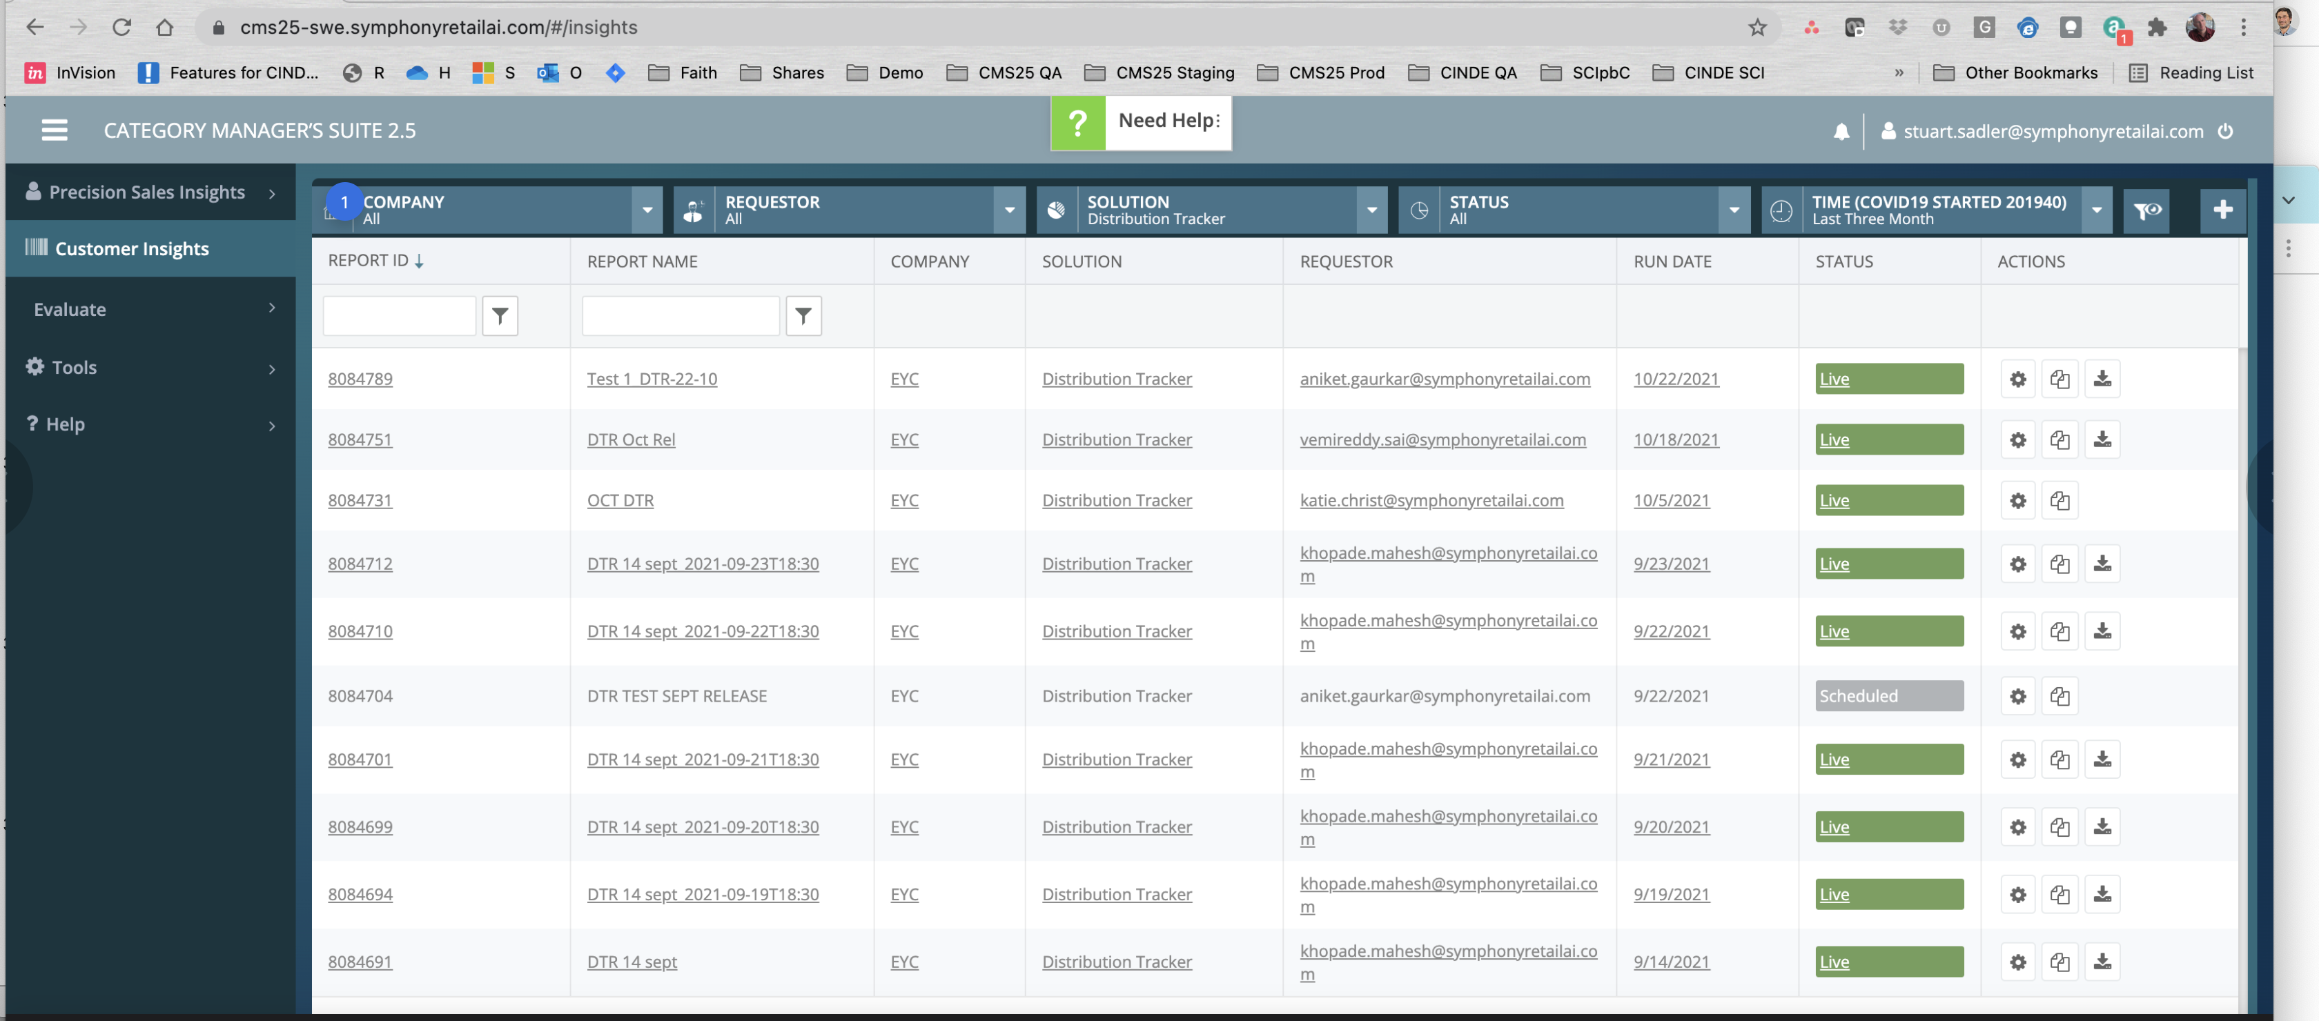

Slide 36
FILTERING UI DESIGN PATTERN: I mentioned the amount of ink used here - another key distinction I want to make is that the most important thing here is to make the SELECTED VALUES loudest and clearest. Imagine these being used to populate a larger page title. Ignoring the "Default" value dropdown, this page might be called <h1>Distribution Tracker (Last 3 Months)</h1> if COMPANY had a selection then: <h1>%companyname% Distribution Tracker (Last 3 Months)</h1> etc. THe point here is that dropdown choices are smaller than the labels instead of vice versa.

Slide 37
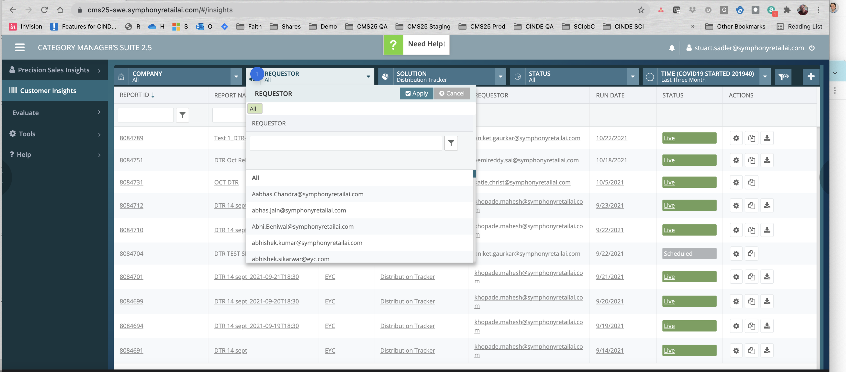

Slide 38
If the idea here is that I can filter all reports by the author (person), then a couple things. 1) REQUESTOR feels odd to me if this is the report Author or rather, just "Created By" perhaps 2) It also feels weird to me that my colleagues stuff is a facet in the searching at this point. Something is off here - perhaps with better understanding of the business question/user goal, it might be justified but initially it feels out of place.

Slide 39
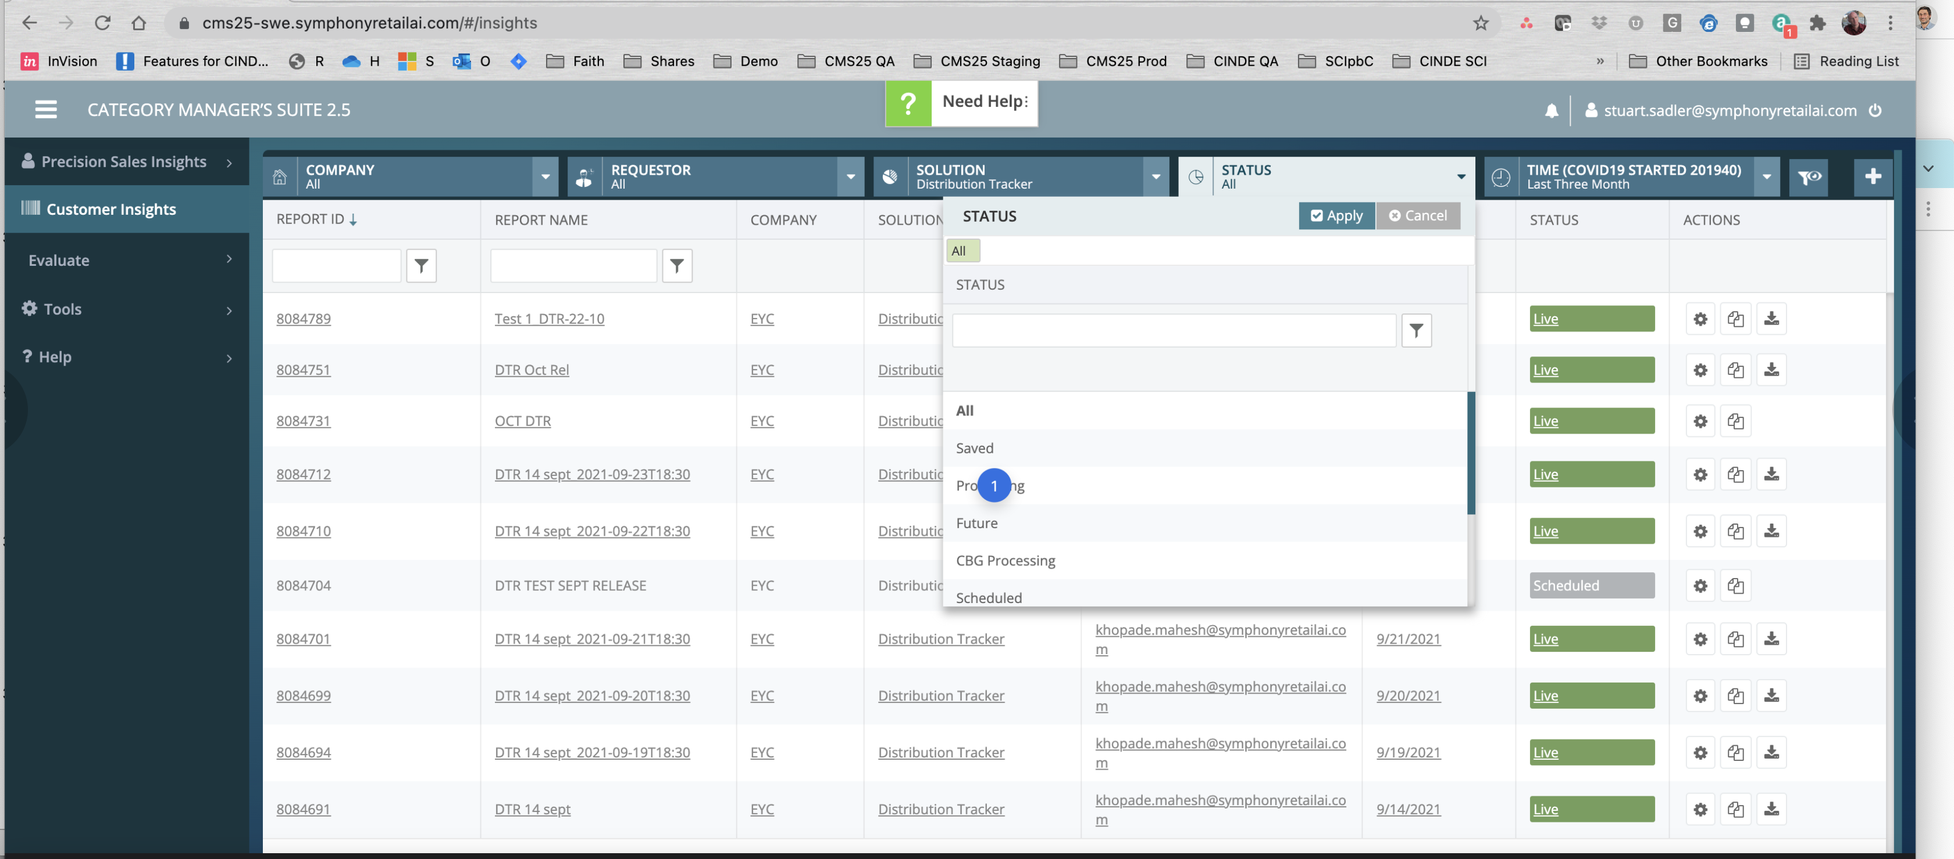

Slide 40
"processing" --> remember the blank dashboard/initial UI screen that i said shouldn't be blank? The fact you have some reports that have to run as jobs in the background is a great example of stuff that should be on a Dashboard. If the user builds a report/output that takes 1 hour to run, they likely would like to know when it's done. While an email/text is probably nice to get , there should be a place that tells the user "hey we know you asked for this, here's the status of these jobs: (2 queued) (4 processing)" --> an ETA for each would be great but I know that can be hard to compute although not impossible.

Slide 41
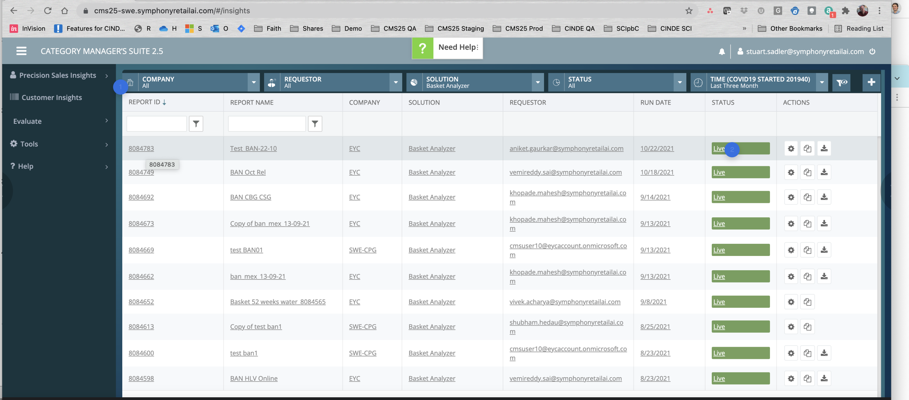

Slide 42
REPEAT : This feels like the 3rd or 4th table styling instance I have seen - unnecessary visual deviations from other screens make it feel like the product is a bunch of features thrown together - this can imply the backend is also somewhat "shaky" and "cobbled together" which directly can play at the brand/quality people perceive from SRAI.
too loud - why is LIVE so LOUD? do we need this much ink to convey this info?

Slide 43
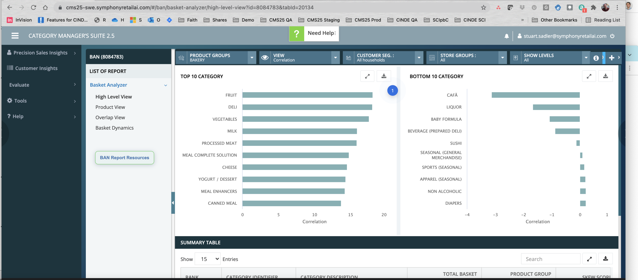

Slide 44
I find these charts very confusing'; no idea what we're trying to convey to users.

Slide 45
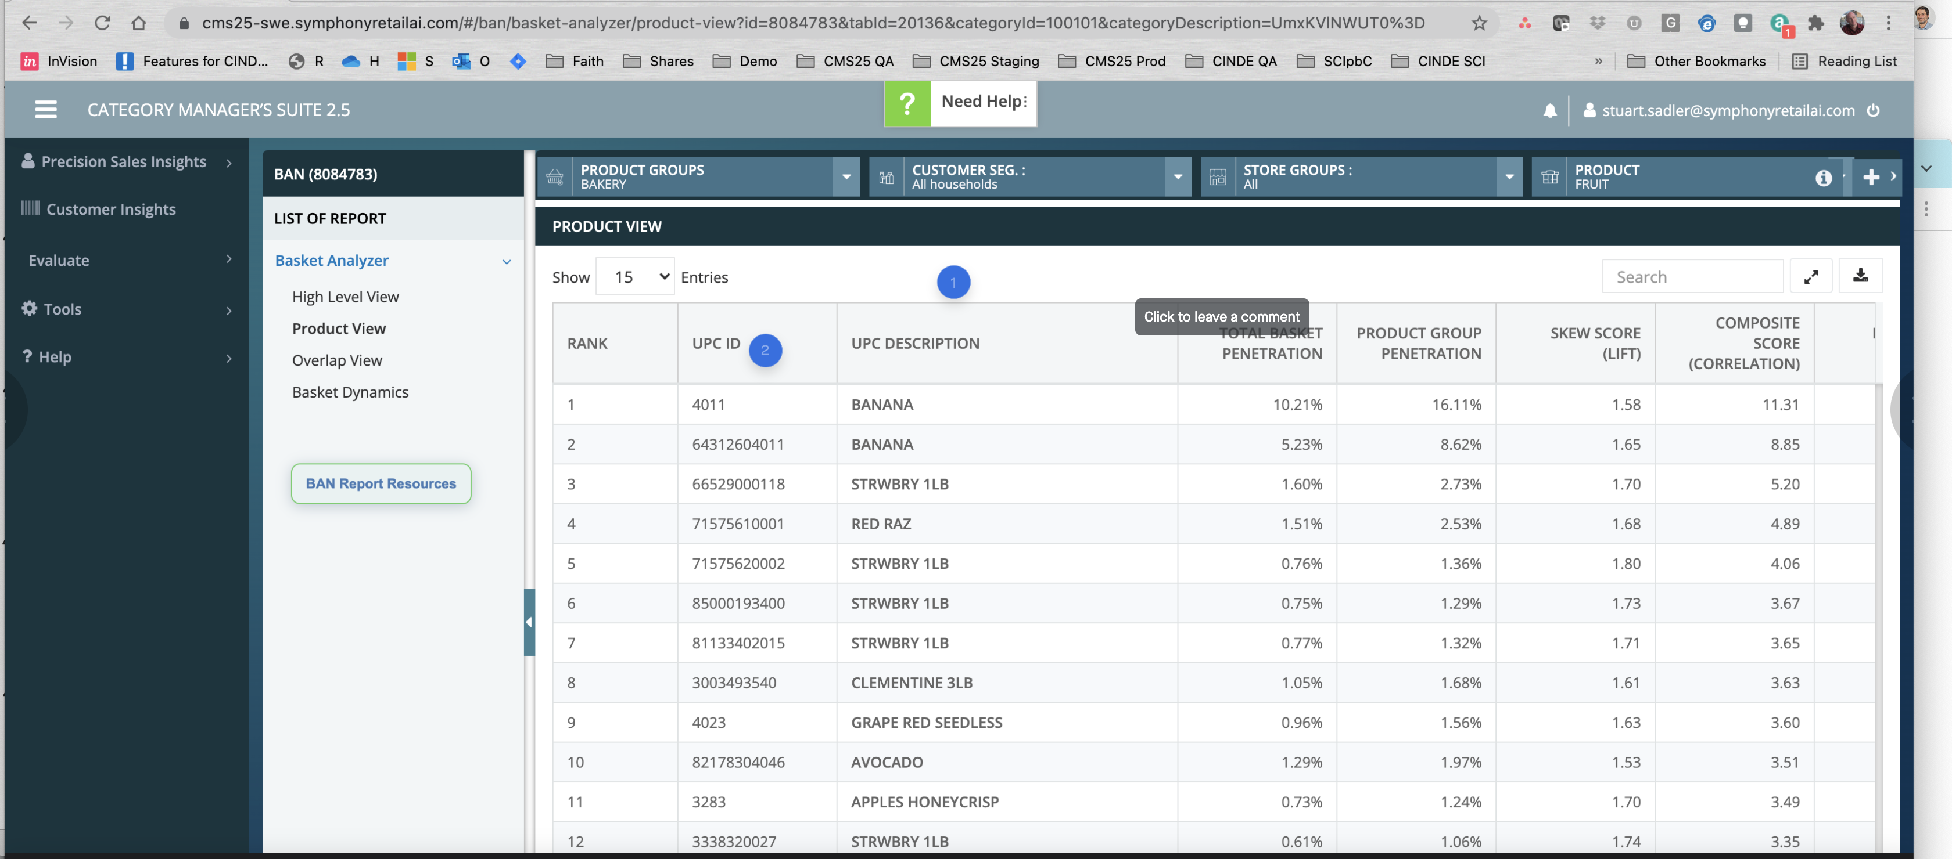

Slide 46
General comment: giant table grids with financial metrics in multiple columns are generally not human-readable if the task at hand is to find insights here. The table cells here could probably benefit from some visualization (bar charts to help the eye find outliers etc). Also, understanding qualitative ranges (I.e. "what is a good lift?" can help users begin to see "what is over or under"? raw data display like this is probably not very helpful except as seed data for excel export). sometimes, there are "find a fact" type use cases, but is that what this UI was designed for? if so, and I am here to find one value such as "the skew for avocados," then i would argue this interface isn't doing a good job of bringing just that to my eye.
wonder if UPC and DESCRIPTION should be combined ; i see no reason to sort by UPC (irrelevant use case) and having it in quiet/gray text near the product name might be easier and take less space.

Slide 47
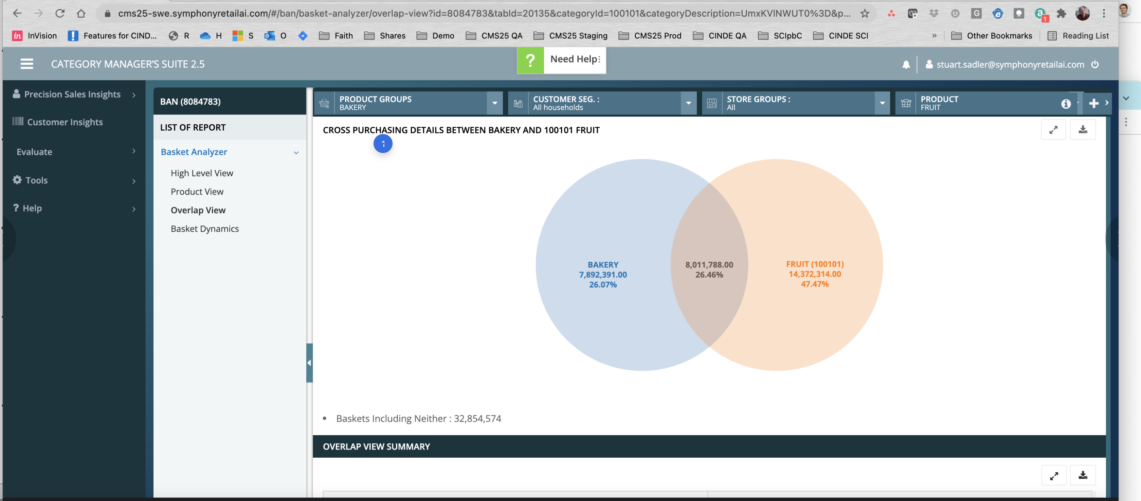

Slide 48
"I want to see cross purchasing details between Fruit and Bakery so that I can _______" ????? The business question this page answers is unclear. What decision downstream are they trying to inform? is two decimal precision needed?

Slide 49
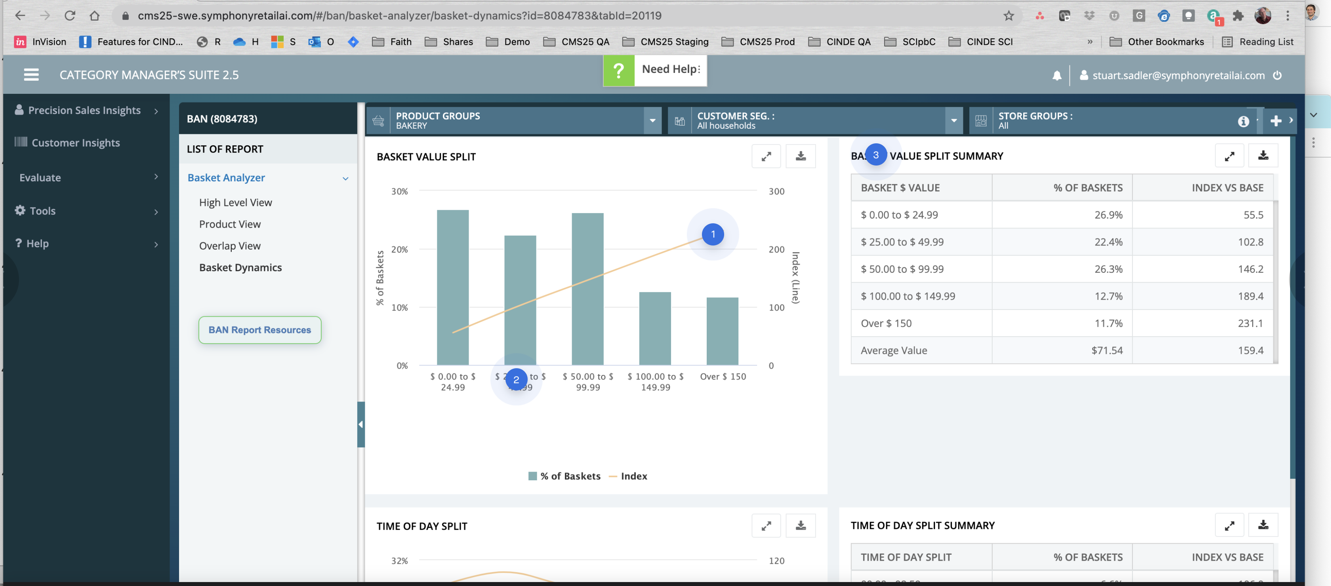

Slide 50
unclear what this is an index of, nor what insight we're trying to show. "I want to see this so that _____ ?"
remove the .00 from these numbers
This idea of "show the table and viz" to me feels odd. if i want tabular data, there can be an export. if the point here is not to look at a point value and instead to understand trends/directions/insights, then remove these tables. Popup/hovers on the chart bars can provide point values if needed. alternatively, use a table with bar charts embedded (however that causes problems if plotting against the index is important)

Slide 51
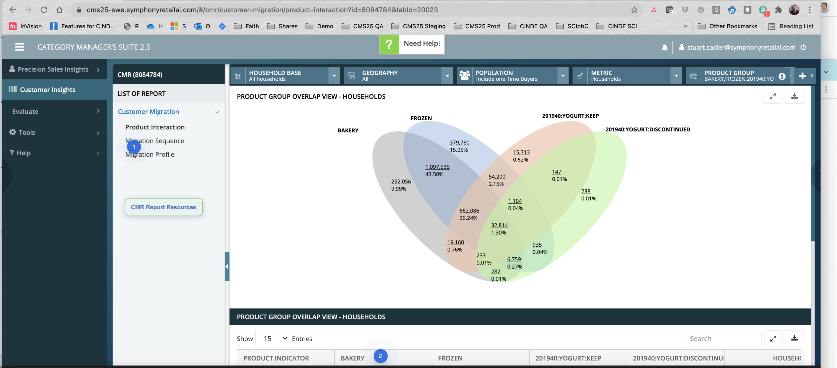

Slide 52
I know what this viz means, however I am not sure what they're trying to do when seeing "how often was this item bought with this item(s)?" There may be better ways to visualize this. With distribution charts, we have to decide what things we want to compare too - so for example, each region of the chart compares to "the whole" in this viz, but the actual shapes are not relative to "the whole" so you get weird situations where the size of , for example, the dark blue and gray regions are approximately the same visual area, but the numbers (9.99% and 43.5%) are wildly different. This is why the downstream questions (business Q and user task) needs to be well defined so the viz can support that. Honestly, the table below this may do a better job. One tactical change if you love the viz - consider stroking instead of filling in the ovals. The color may not be helping and a simple stroke may be sufficient.
1) I wonder if offering a checkbox on the TH col headers to filter on "value=y" would help (i.e. hide rows that done have "Y"). 2) consider a checkmark instead of Y if Y simply means "true" i imagine that there are likely scenarios where somebody is comparing the basket to a specific single item - i.e. "understand what they are buying with BAKERY" and so you might want to lock in some params and then explore the other combos.

Slide 53
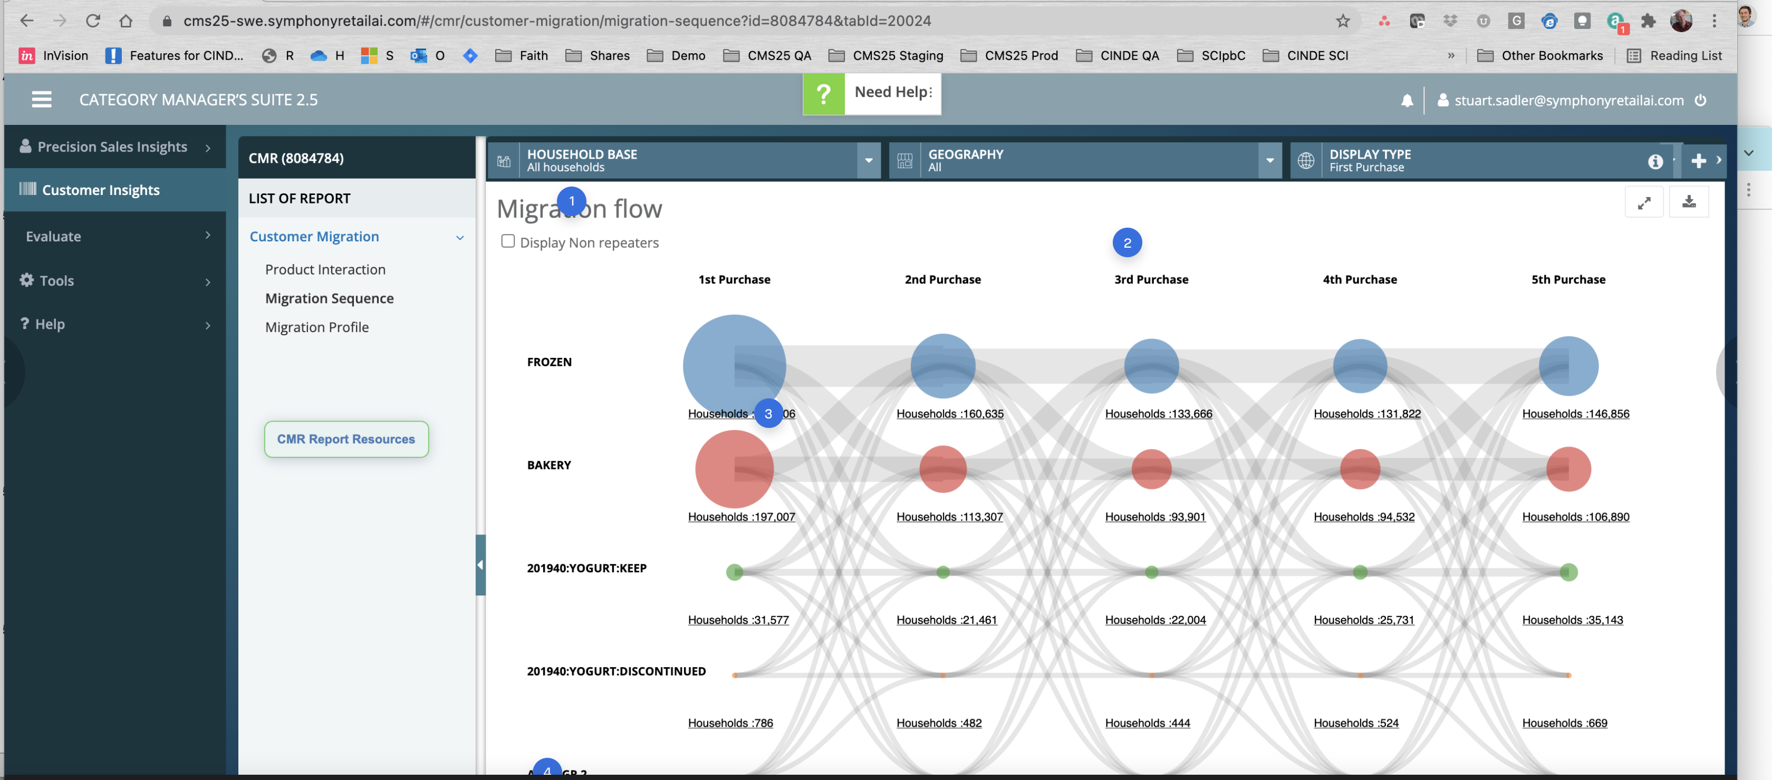

Slide 54
@StuartSadler @ErnestoLaval probably will need a 15min meeting to review the intent of this together. can one of you grab a time with me? https://calendly.com/designing-for-analytics/15mins
Tactical fix: Do not repeat the word "purchase" on every column. Just have one super title "PURCHASE" and then something like "1st" "2nd" etc. General UI Guideline: when you see labeling words on tables or charts repeating over and over, there is usually a way to remove the repeating word to add clarity.
1) General feeling is that percentages, not absolutes, would be a better value here. The problem may be in clarifying "% of what?" That said, absolutes feel strange to me here and large numbers once again probably have too much precision given this viz is about comparing some type of aggregates. 2) remove underline on the word households. :hover state underline is fine if you want to show that it's an affordance for a drilldown or something. 3) remove the word HOUSEHOLDS in this viz - it doesnt need to be printed 25 times. You may want to just print it on the top left data point once and then let the hover popup clarify that this is what the label is.
I dont know what this label means except that it is probably a custom product group. That is fine, however , if users are trying to do some type of task where they are trying to see how big of a share o the purchase visits their [tiny] product group is relative to the major categories, you're going to have an issue where their group is always a "tiny dot" relative to the big guns (i.e. bakery or frozen). This is another hint to me as to why I am a little suspect of this visualization.

Slide 55
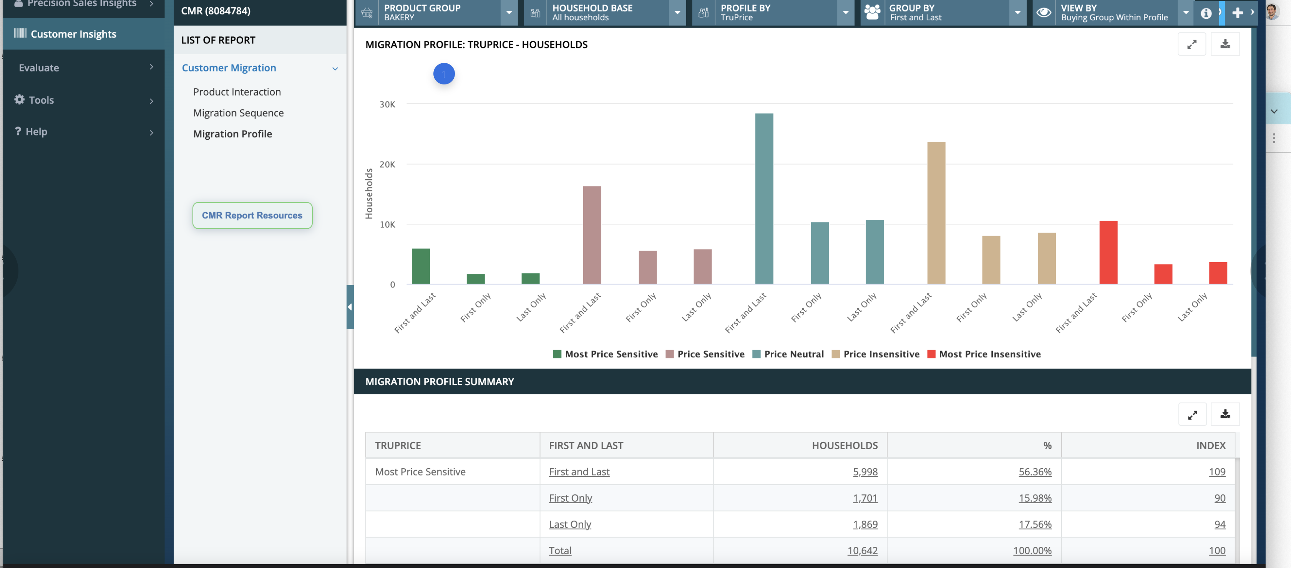

Slide 56
consider using "small multiples" and reducing the size of this entire plot. i would also rotate 90 degrees so you dont need diagonal labels. Small multiples will help the segments i.e. "price sensitive" vs "most price sensitive" stand out better. The downside is that it would take some of the data points off a common bottom X axis and so the business question + user scenarios would need to be better understood. For example, if comparing "most price insensitive - last only" to "most price sensitive - first only" is relevant, the small multiples version may make this slightly harder since bars may no longer line up on a common x-axis. The point is that there is no 1 right viz: each one favors different types of comparisons. Suffice to say though, even if you decided to leave these on a common bottom x axis, the overall viz is way larger than it needs to be with too much white space activation. This is a common problem in the GUI, and another reason I want the "maximize" control removed from most of the CMS plots. Most of the plots are already larger than necessary and are actually low information density. Maximizing just activates more white space and noise; this control should be carefully included only when the viz really can benefit; just including it all the time as a "standard" for consistency's sake isn't necessarily valuable. If you dont want to remove it, consider burying it in an overflow menu / dropdown so it's not as present.

Slide 57
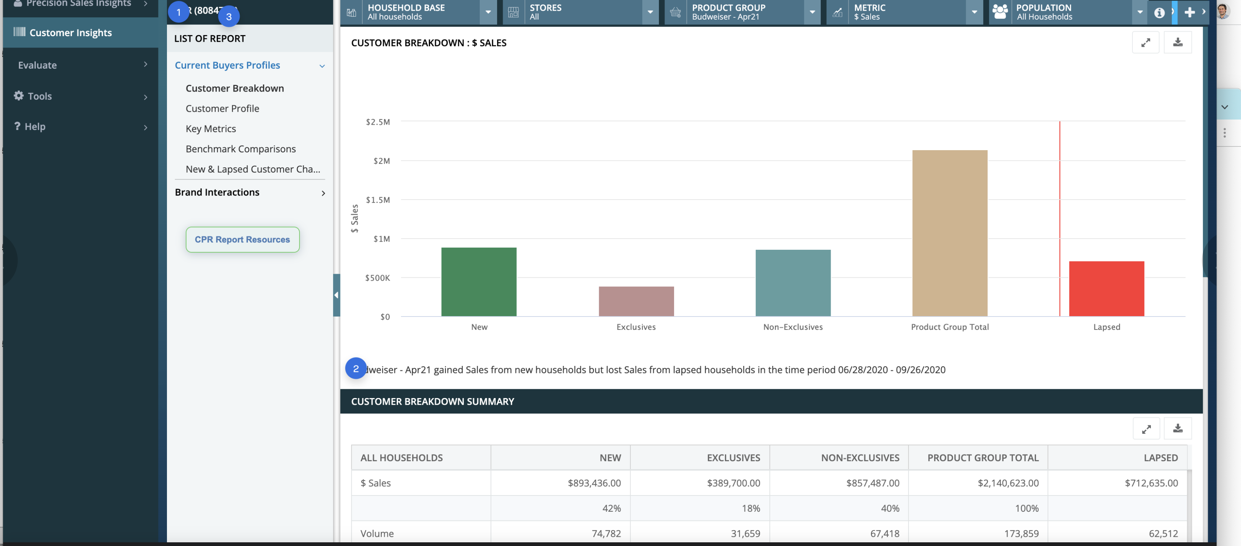

Slide 58
Ok, so if the previous screen was "Customer Profiler" and this is the NAME of a specific Customer Profiler report, then I get that, but I'm not sure users would . It feels odd to me that the words "customer profiler" no longer appear in this GUI. I think I "built" the report on the earlier pages" and now I am accessing/viewing, but there is a visual and cognitive disconnect IMHO. A breadcrumb may be helpful but that feels like a quick bandaid to a possibly larger information architecture issue.
OOOOOHHHH! This feels like a nice like Conclusion - neat and tidy. but it's buried in here. while this exact one may not be that relevant, it's these times of conclusions that can be really helpful to summarize a plot - before showing the plot (evidence).
So, this simple bar chart pattern: when there only a few data points being plotted, and you have a table below, chances are, the entire page could be consolidated into a table that includes bar charts within it. There is very low information density in these bar charts which again , like others, are way oversized for the amount of signal they contain. Once that is done, it may even be possible to consolidate the entire "list of reports" at left into a single GUI/page. This is probably dependent on the scaling and choices in the dropdowns but consolidation would remove the need to hunt for relevant information

Slide 59
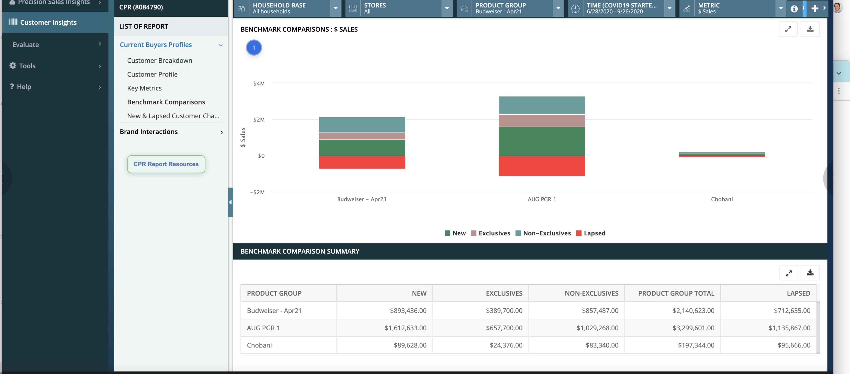

Slide 60
in general, stacked bar charts can be problematic; unclear if the data points share a common baseline, or the data points are additive. I also dont understand what Lapsed is in this context - I do see the definition in the .xls doc but it's unclear to me what the red data is. If this is industry lingo and the term is very well defined, it may be ok as-is but trying to cross-ref with your definition was difficult. This visualization is also problematic if users are trying to compare things like 1 product group Exclusive to another exclusive in another product group. I may have additional feedback based on the intended understanding of what Lapsed is. I dont understand the object model of a product living both inside of a defined product group like "beer" and outside of it. (Lapsed to me means sales of Budweiser products that are somehow "outside" the product group.) The only thing I could guess was maybe this means stuff like 1-off cans of Bud sold at the checkout register instead of the Bud sold in the Beer Section of the store.

Slide 61
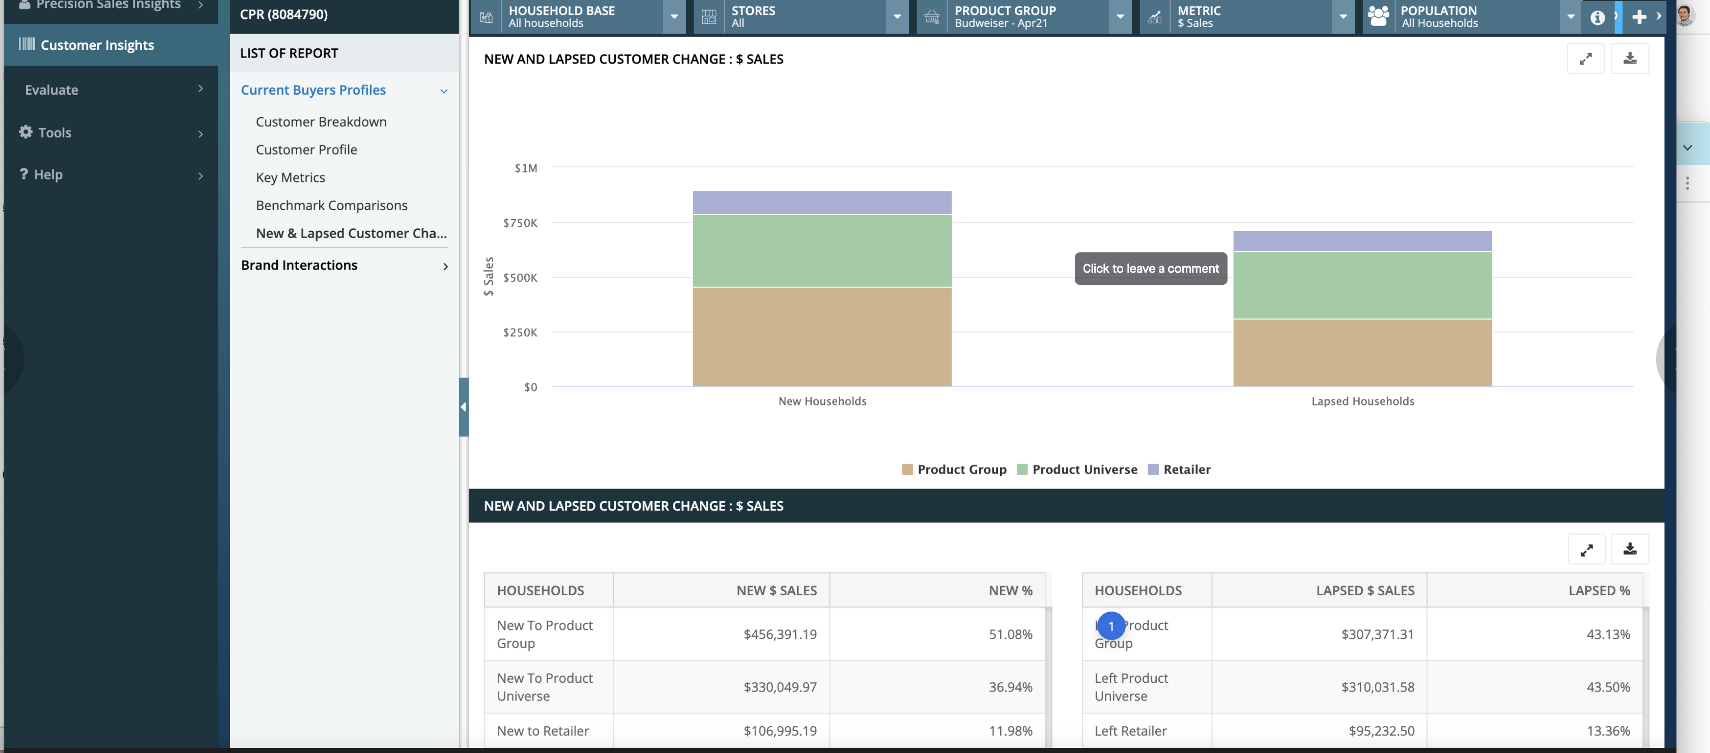

Slide 62
Are Left and Lapsed the same thing? why the change in terms if so?
This viz: I am wondering if the distribution by household here is meant to be the primary focus here or whether the goal is to compare segments across the 2 HH types? for example, Retailer sales are visually about equal as are Product Univ. sales across both HHs - however, because the brown bar heights differ a lot, the comparison is hard to make. Among the recurring issue with the plot size scaling large "because it has room," it's not clear to me what the use case is and whether this viz makes sense or not. I wonder if a single HORIZ. bar chart, painted left to right that looks something more like: BROWN BROWN GREEN GREEN PURPLE PURPLE TOTAL NEW TOTAL LAPSED Might allow for more rapid comparison of values. Again, what's the decision being made? that will drive the answer here. All that said, I do think that comparison of 2 distributions with unequal sums is difficult visually to do.

Slide 63
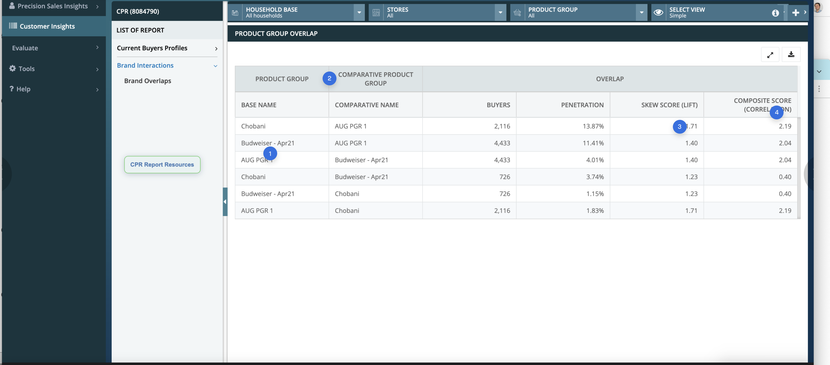

Slide 64
COnsider using table Rowspans here to reduce repetition of labels. So: Chobani | AUG PGR 1 | Budweiser Apr 21 AUG PGR 1 | Chobani | Budweiser Apr 21 Budweiser Apr 21 | Chobani | AUG PGR 1
This might be reduced to a colspan header with 2 subheads like this: PRODUCT GROUPS __________________ Base | Comparison I'm confused though that the math/metrics are different given each combo appears twice e.g. Chobani<>Budweiser and Budweiser<>Chobani. The CCR glossary did not help me clear this up after many minutes of study; it seems as though some of these metrics are based on the presence of 1 UPC within a Group and others are the presence of ALL UPCs within a Group. That info is not pictured here and while it's possible those with domain knowledge would get all this, I am guessing these were at one point CMS-specific calculations/concepts that may not be readily understood.
is this 1.71x? what is good? what is the max value? To me this index is a little vague.
"2.19 as compared to what?" again, the index is not particularly clear to me

Slide 65
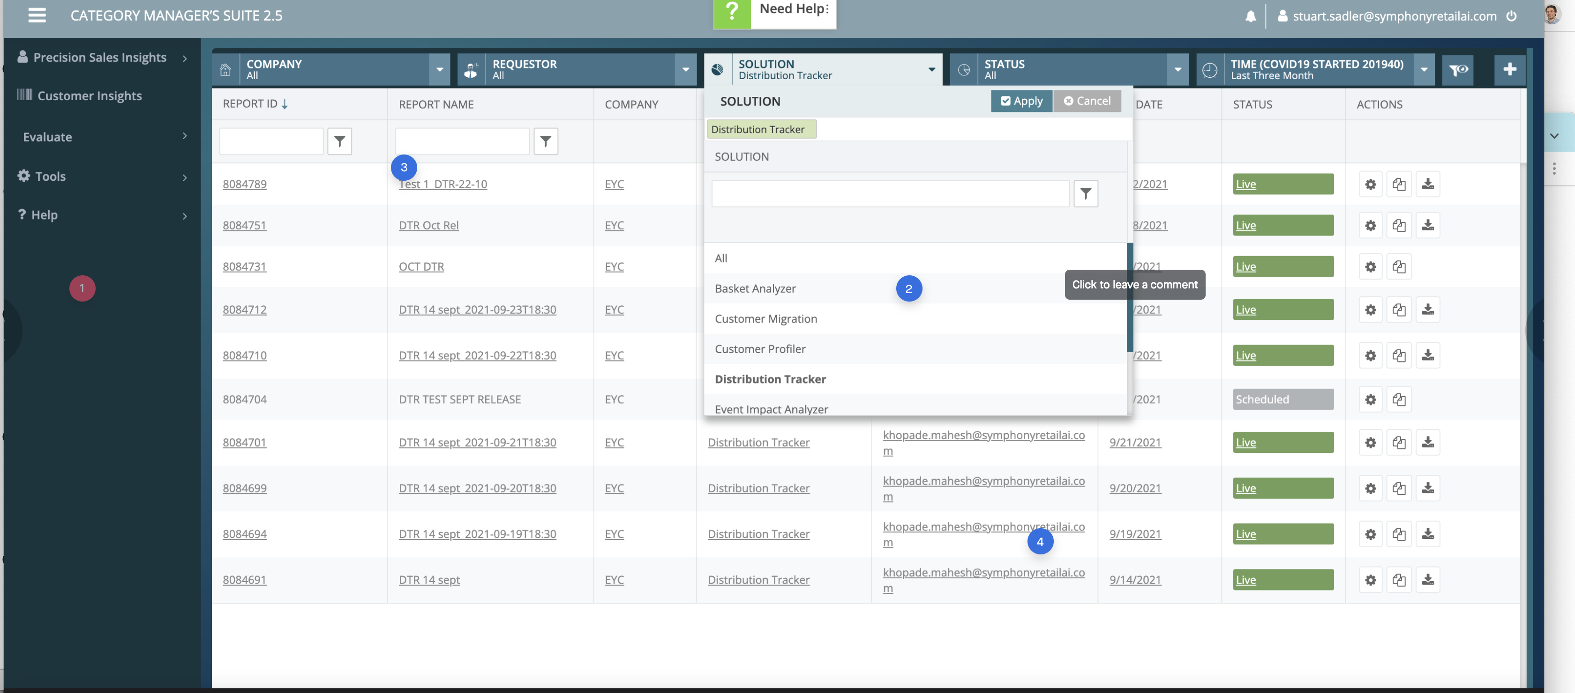

Slide 66
Info Architecture suggestion (IA): if SOLUTION basically means REPORT TEMPLATE (UI), it may be worth surfacing this earlier as a primary navigation item - not as a filter/sibling to things like "Requestor" or "company." UX wise, we talk about "information scent."My guess is that people are more likely to come in here with an objective related to these reports like "track an impact" or "analyze a basket so i can do x" -- not "i want to create a product group and then do stuff with it." Creating a product group sounds to me more like a required task that supports a job or user objective - not an objective itself. I don't just wake up and decide to make a product group; a business question drives this i would think. Right now, these are the closest things to verbs/action/jobs-to-be-done in the GUI and so I would want these words -- even if the reports themselves aren't great -- surfaced earlier in the UX so people can at least get to the right page/view, and then perhaps input whatever criteria are required. even better: provide value as soon as I land on one of those. Chances are, there are useful insights, rollups, benchmark comparisons, anomalies, projects being tracked, etc (as discussed re: the blank dashboards). In other words, while it is true i may be in here with a job to be done like "analyze basket x so I can do y" it is also a chance to show them "hey, look at these baskets over here! isn't this unusual/interesting?"
on all these GUI index screens, I am curious what realistic data actually looks like. Is timestamping a regular naming convention? That suggests that some sort of date object is missing in the system. I would also wonder if the report ID really needs to be here; a Description field seems like it might help particularly if reports are shared between users. finally - if the hyperlinks all go to the same place consider removing the extras - just link the report name to the report view. otherwise, users are presented with more unnecessary choices than they need to go do the same work.
i mentioned my feelings about the email address/author column here. if you plan to keep this in, you might consider hiding the domain name if its always the same or use some sort of truncation function to reduce the width of this column. For example , if 90% of the people are going to have a PG.com proctor and gamble email address, just hide or truncate like John.Doe@pg... Jane.Doe@pg... and if I appear, then show my whole email: brian@designingforanalytics.com or just use a right-truncation function to trim out most of the email except the username portion.

Slide 67
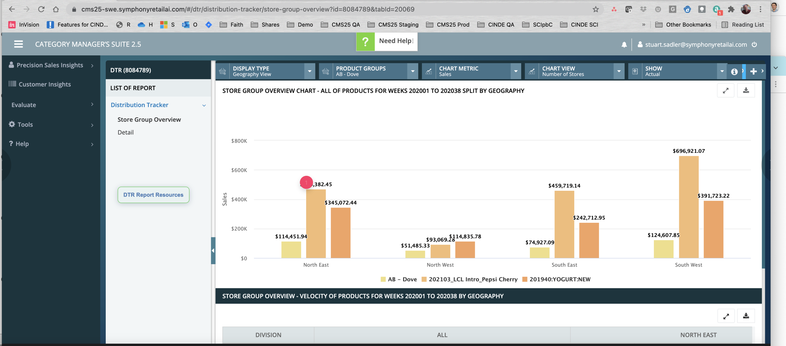

Slide 68
again, level of precision is way too specific for the default view (popup is fine to have this down to decimals). Same comments re: information density in this view (Very low; likely should be consolidated with Detail to tell more story).

Slide 69
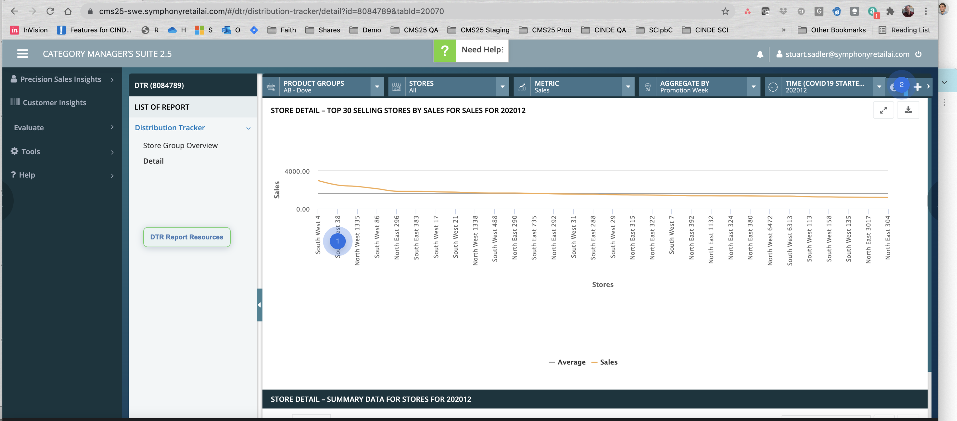

Slide 70
This visualization is very hard to read; consider a slope chart if the goal is really to see "what stores are performing differently than normal over the period." Additionally, the line chart is inappropriate as the data is not contiguous from store to store. Use bars if you are going to keep it. Small multiples (each store's sales performance over N months) might also work - and if you work the viz into the table below as stated in other views, you may be able to provide a lot more information density in a smaller compact space.
layering problem here (bug)?

Slide 71
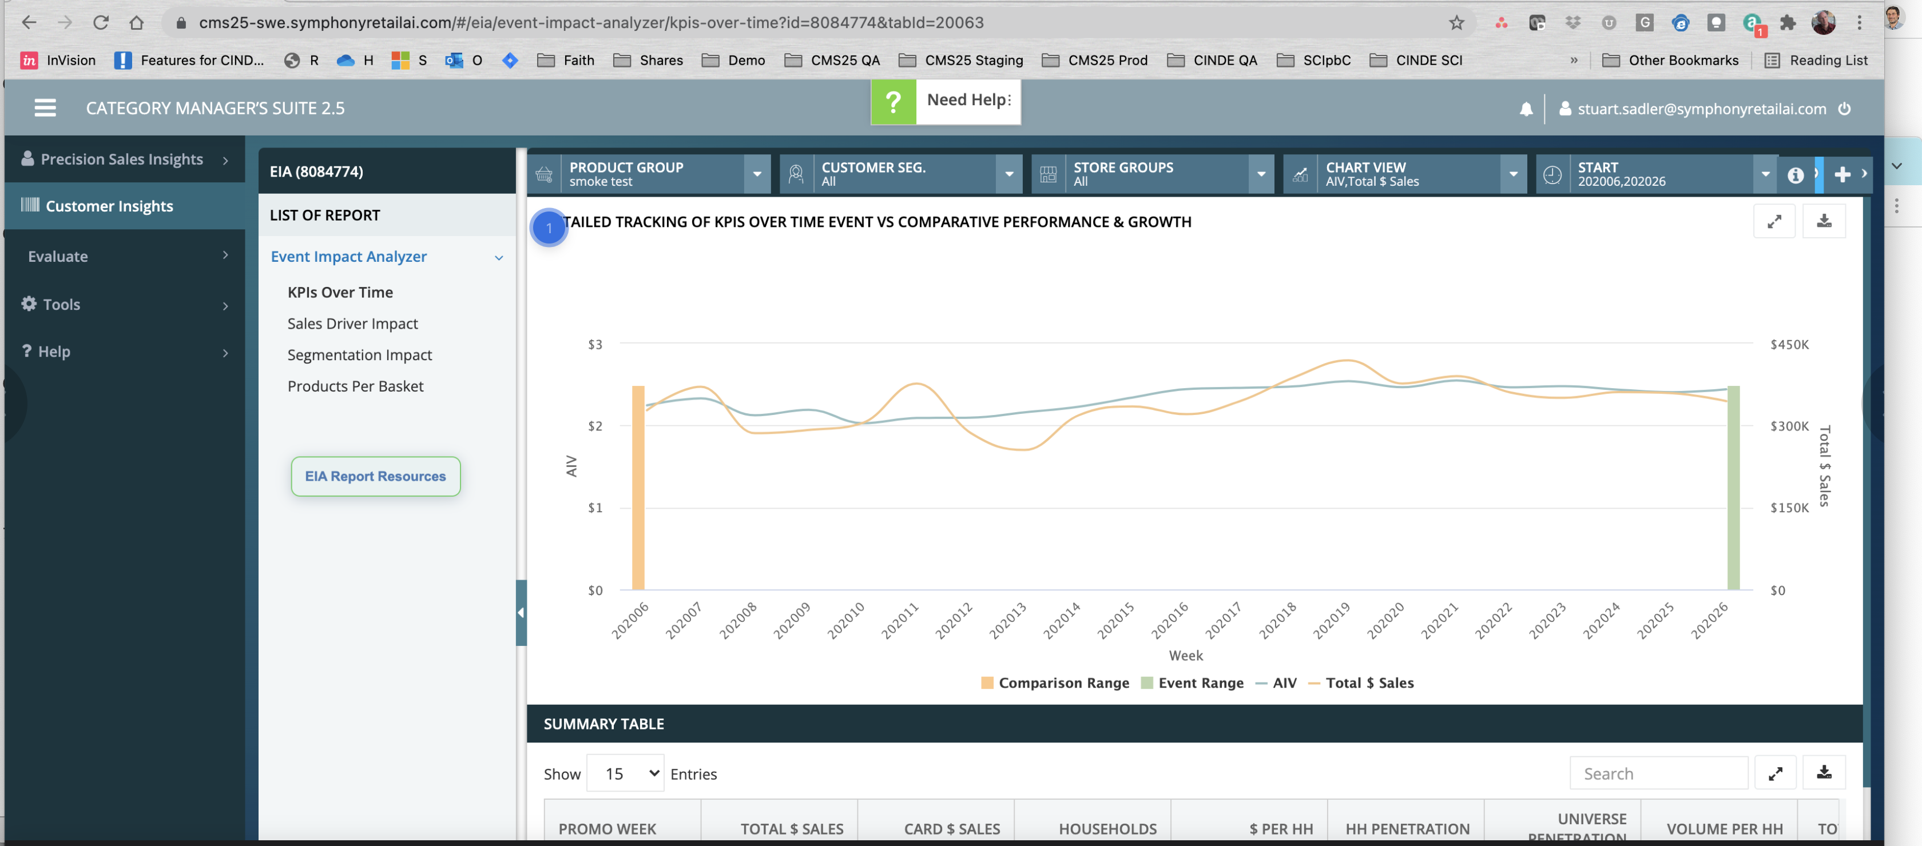

Slide 72
Honestly, even after going into the Coles pptx which is the only other instance of EIA i could find referenced, i still dont understand what this chart is trying to tell me. Generally, I recommend shying away from charts with two different Y axes; sometimes, just stacking two charts and reducing Y plot size is sufficient and removes some of the cognitive load required to home yourself. I don't understand what an Event Range or Comparison Range is and the word "over time event" vs. "over time" in the chart title is also odd. If these two things mean the same thing, i would remove the word "event"

Slide 73
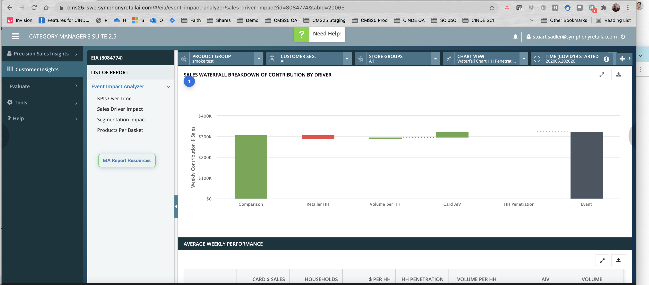

Slide 74
Again, this could be a domain knowledge issue, but unclear what the user goal is and what this collection of metrics is trying to explain to me.

Slide 75
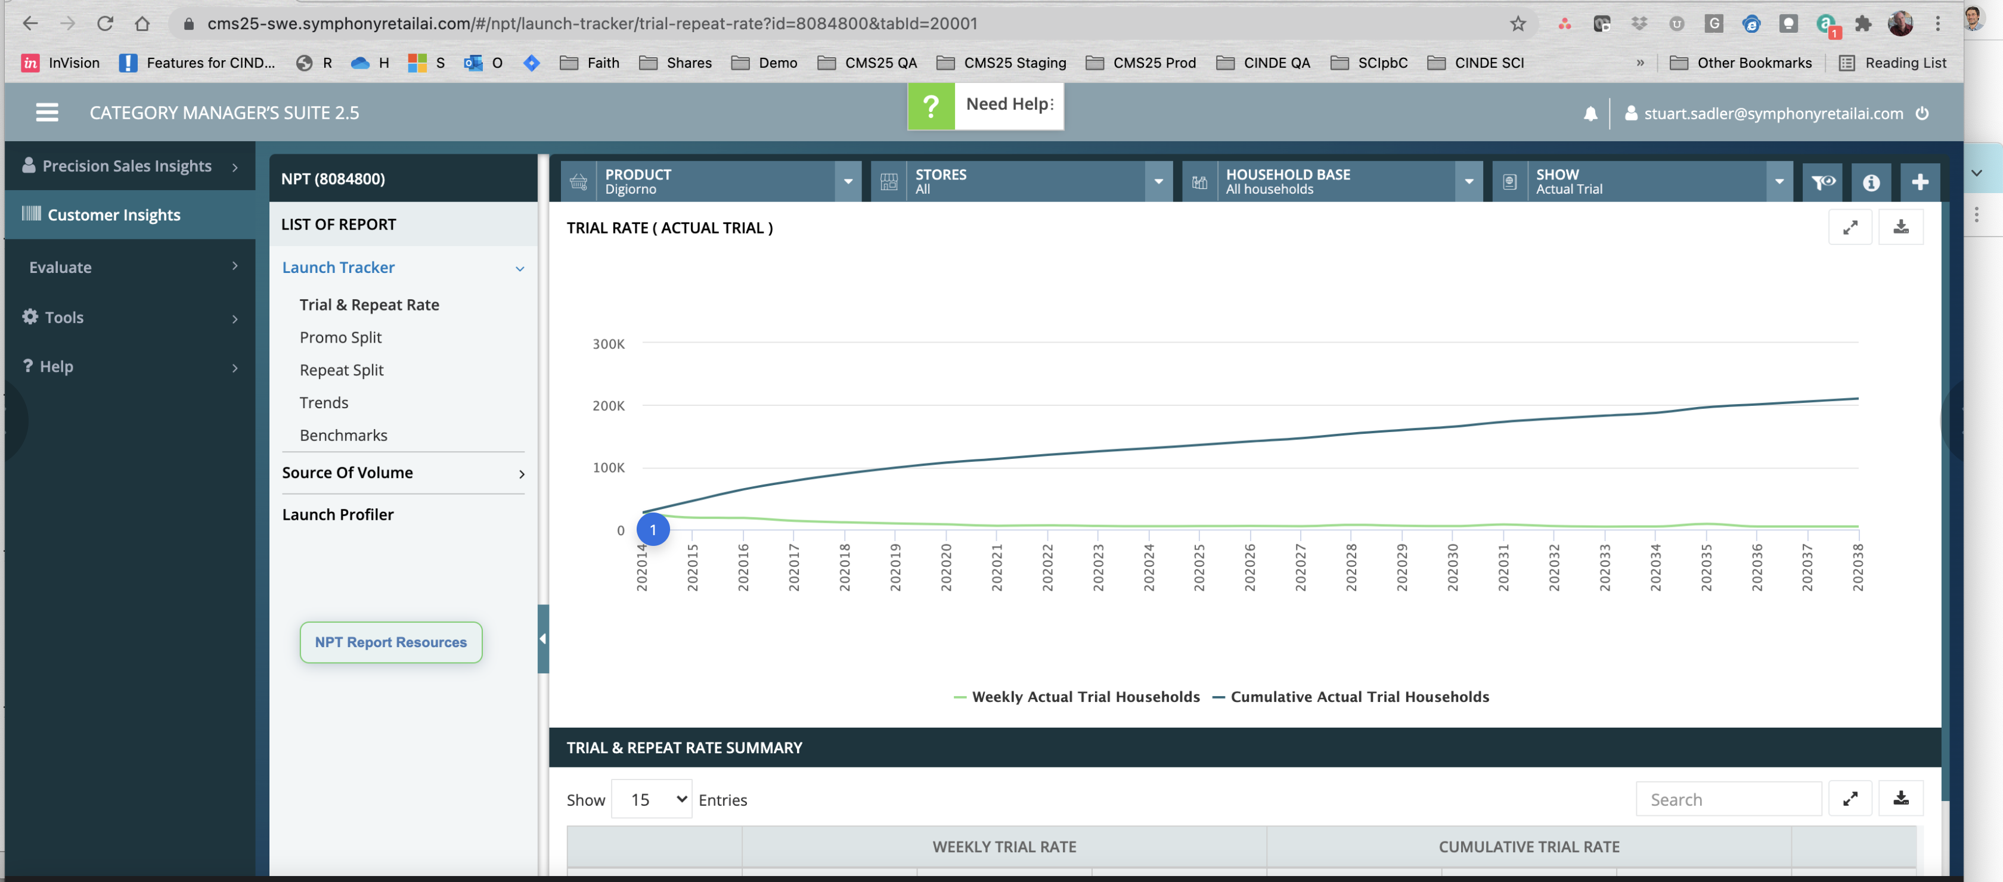

Slide 76
Green line - be careful here- is the data actually contiguous or is it weekly samples? it may not matter too much but it's worth investigating.

Slide 77
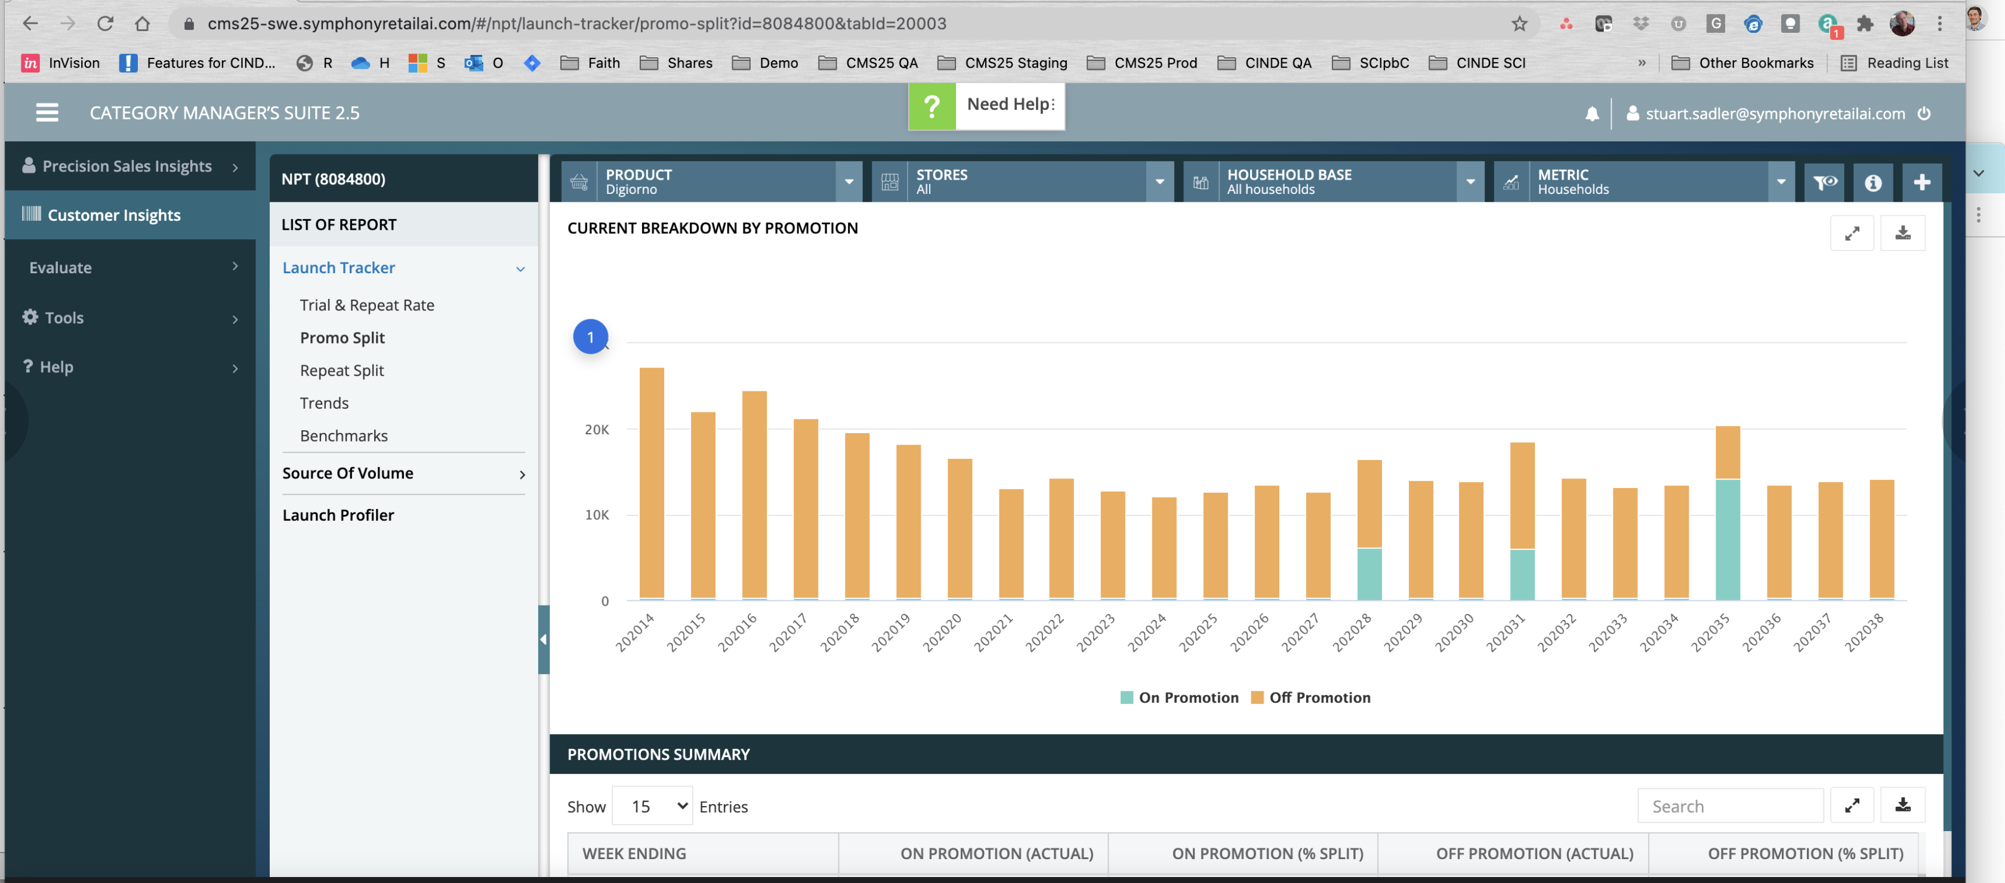

Slide 78
Candidly, I don't know what the units are of the Y axis. households? What does it mean to say "this household is ON a promotion?" If this is well known domain knowledge, then ok - it doesn't seem intuitive to me but it may be.

Slide 79
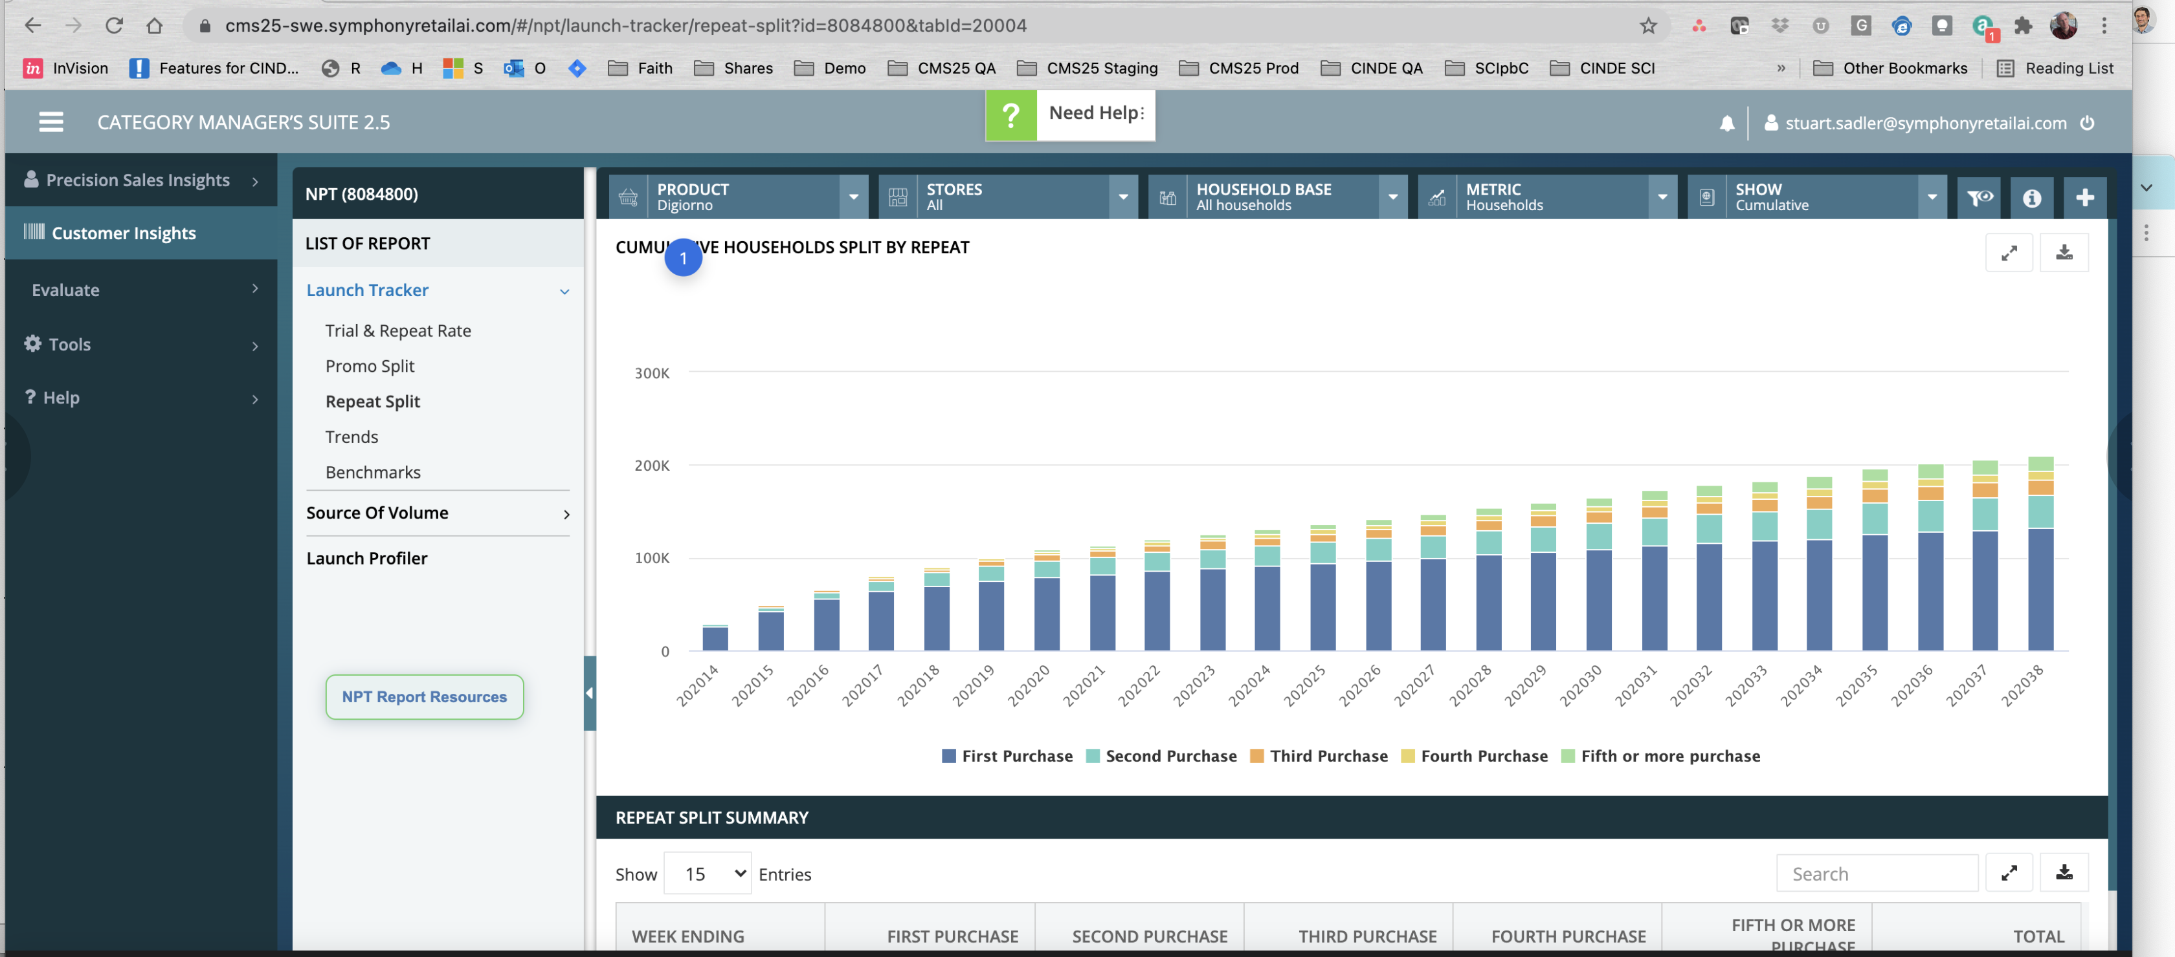

Slide 80
Unclear what user scenario this UI is trying to solve for. this chart will always go up and too the left being cumulative so there must be something here about comparing the distributions that is more interesting. however, stacked bars are hard to do comparisons against.

Slide 81
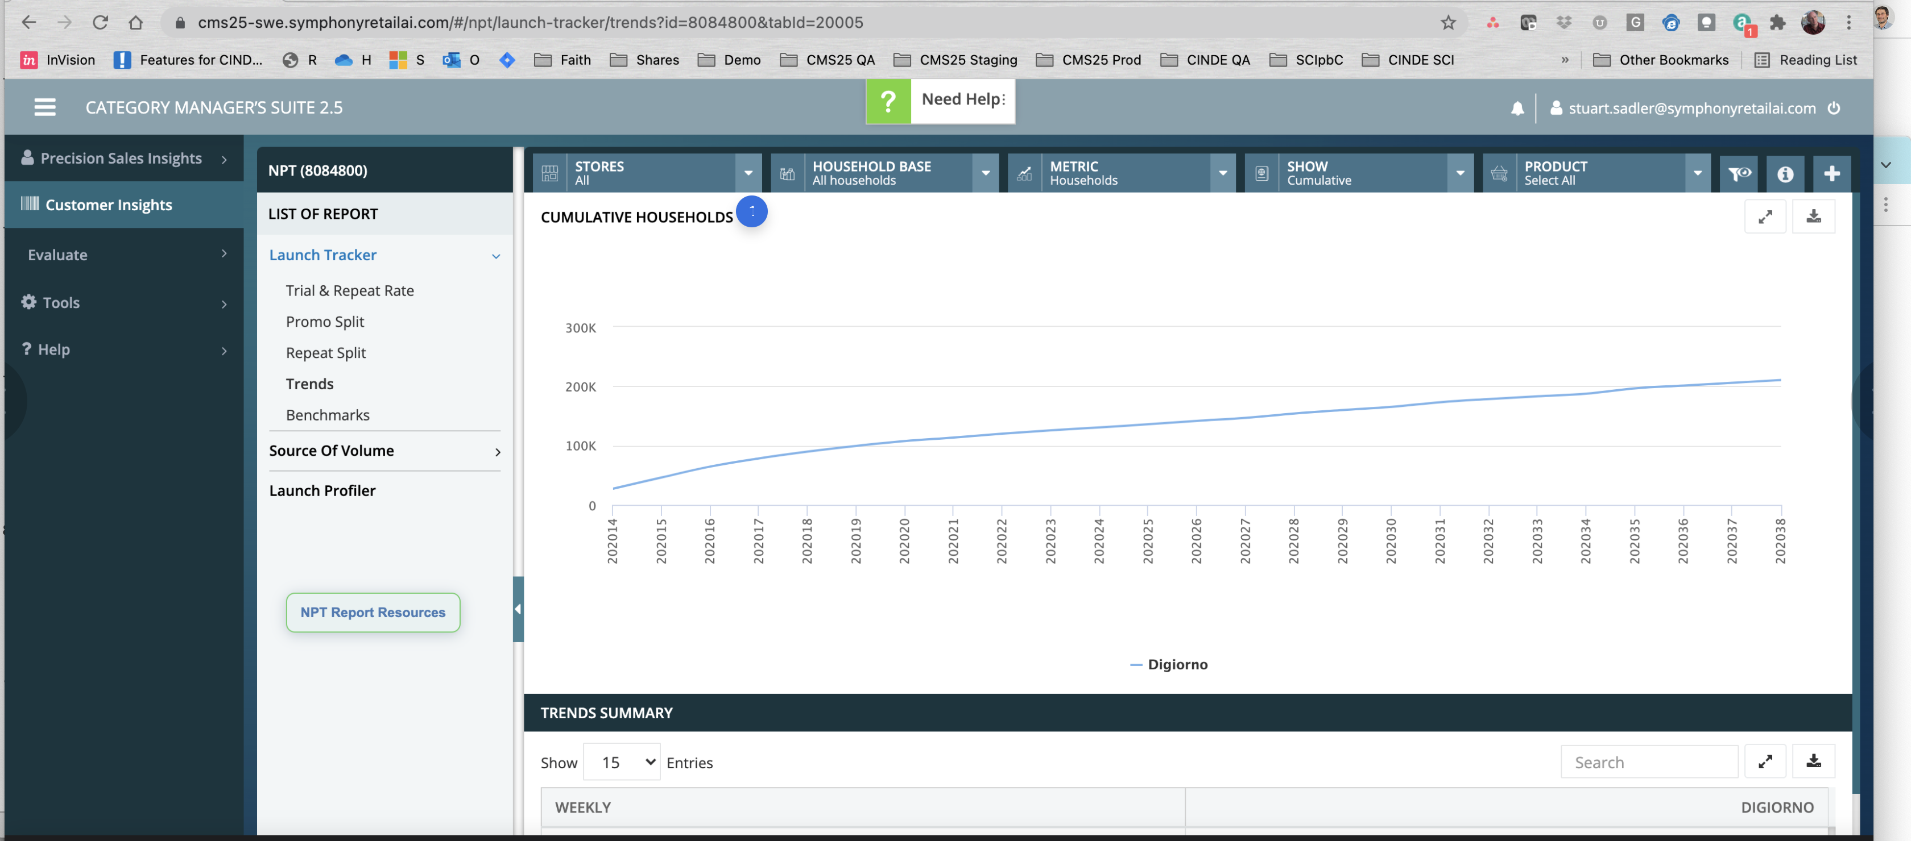

Slide 82
This entire page could likely boil down to a tiny widget, and it is likely only useful as an anchor for other comparisons. As stated many times before, many of these sub-reports on the left could likely be consolidated to allow more eyeball analysis, less clicking and searching.

Slide 83
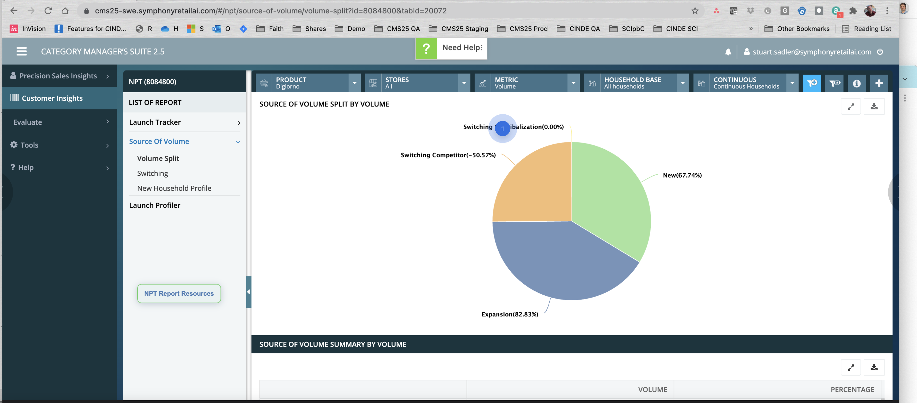

Slide 84
Same comments about consolidating views like this into a much smaller footprint - i also avoid pie charts for obvious reasons you likely know (slices are harder to compare than bars).

Slide 85
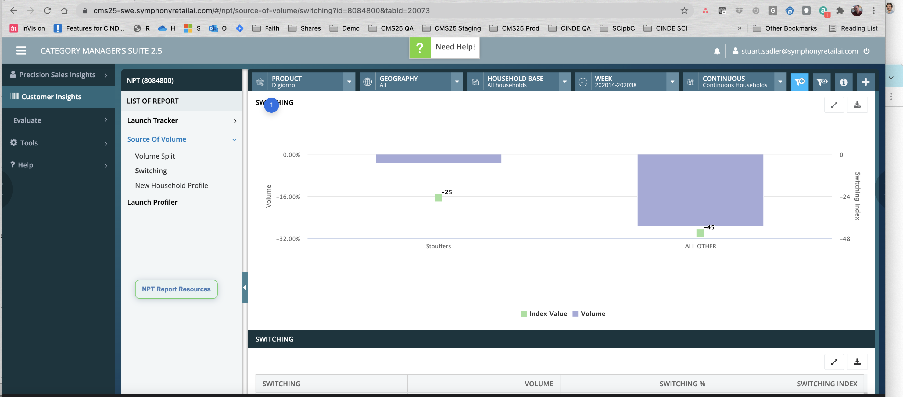

Slide 86
Totally lost as to what story this is trying to tell me. I think something about which people went from the seleted Digiorno brand to Stouffers but cant grok it. Also unclear what that means (i.e. how is a Switch defined exactly?) Maybe the (i) icon tells us.

Slide 87
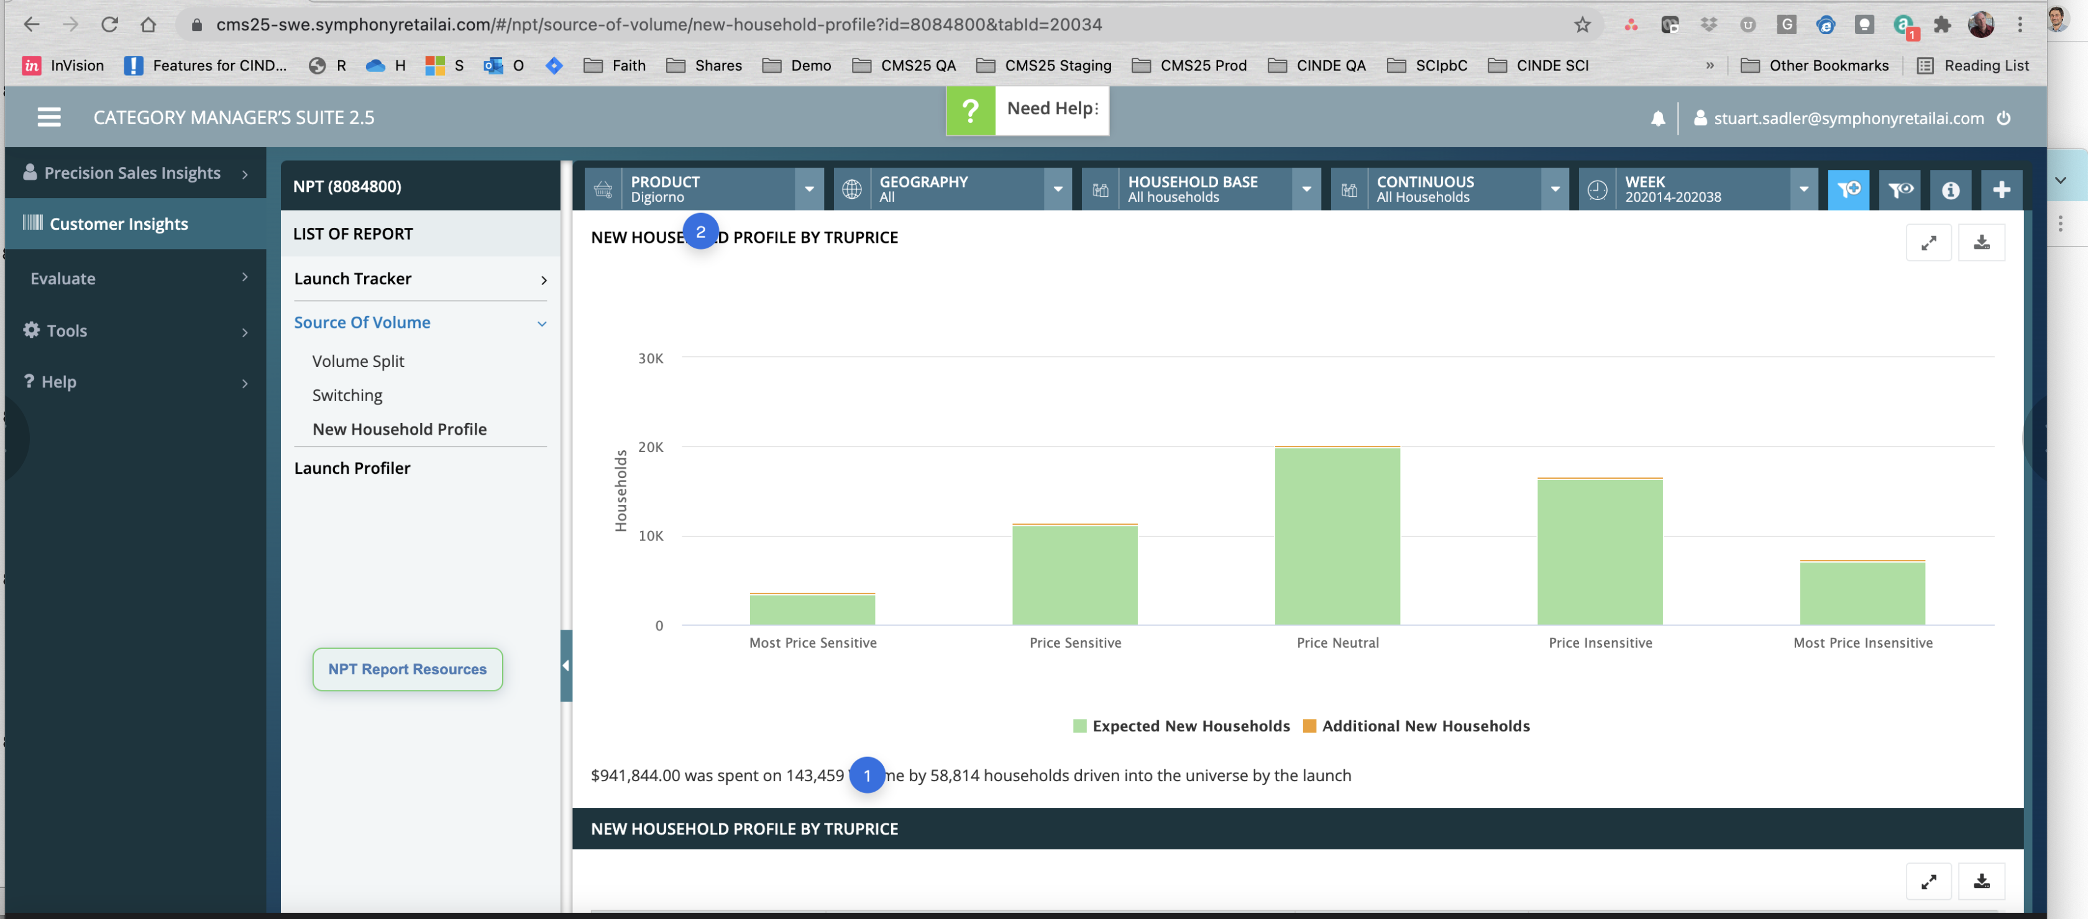

Slide 88
volume...or units?
If the goal is "how many new households did we sell a unit of the selected new product to during the selected time frame", then I'm not sure this viz is doing a great job. It's also not clear whether "expected new households" means households that actually bought a unit, or households that were predicted to buy a unit whether they did or not. Finally, it's not clear which comparison this plot is trying to support. if the goal is to understand which price bracket saw the most additional new households, and the Expected is always going to be an order of magnitude larger than Additional, then this plot is going to always scale improperly -- making it very hard to compare the orange heights (if that's actually the goal). Whenever we get into plotting multiple variables, the choice of plot will favor and unfavor certain types of comparisons.

Slide 89
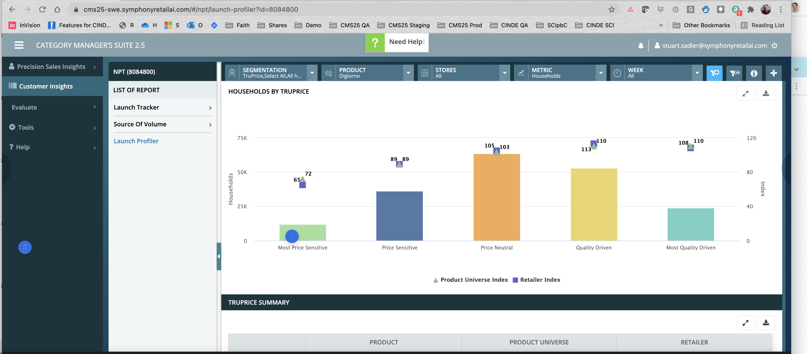

Slide 90
remove the color changes between truprice segments. the changing color is making the graph even harder to read. pick one color.

Slide 91
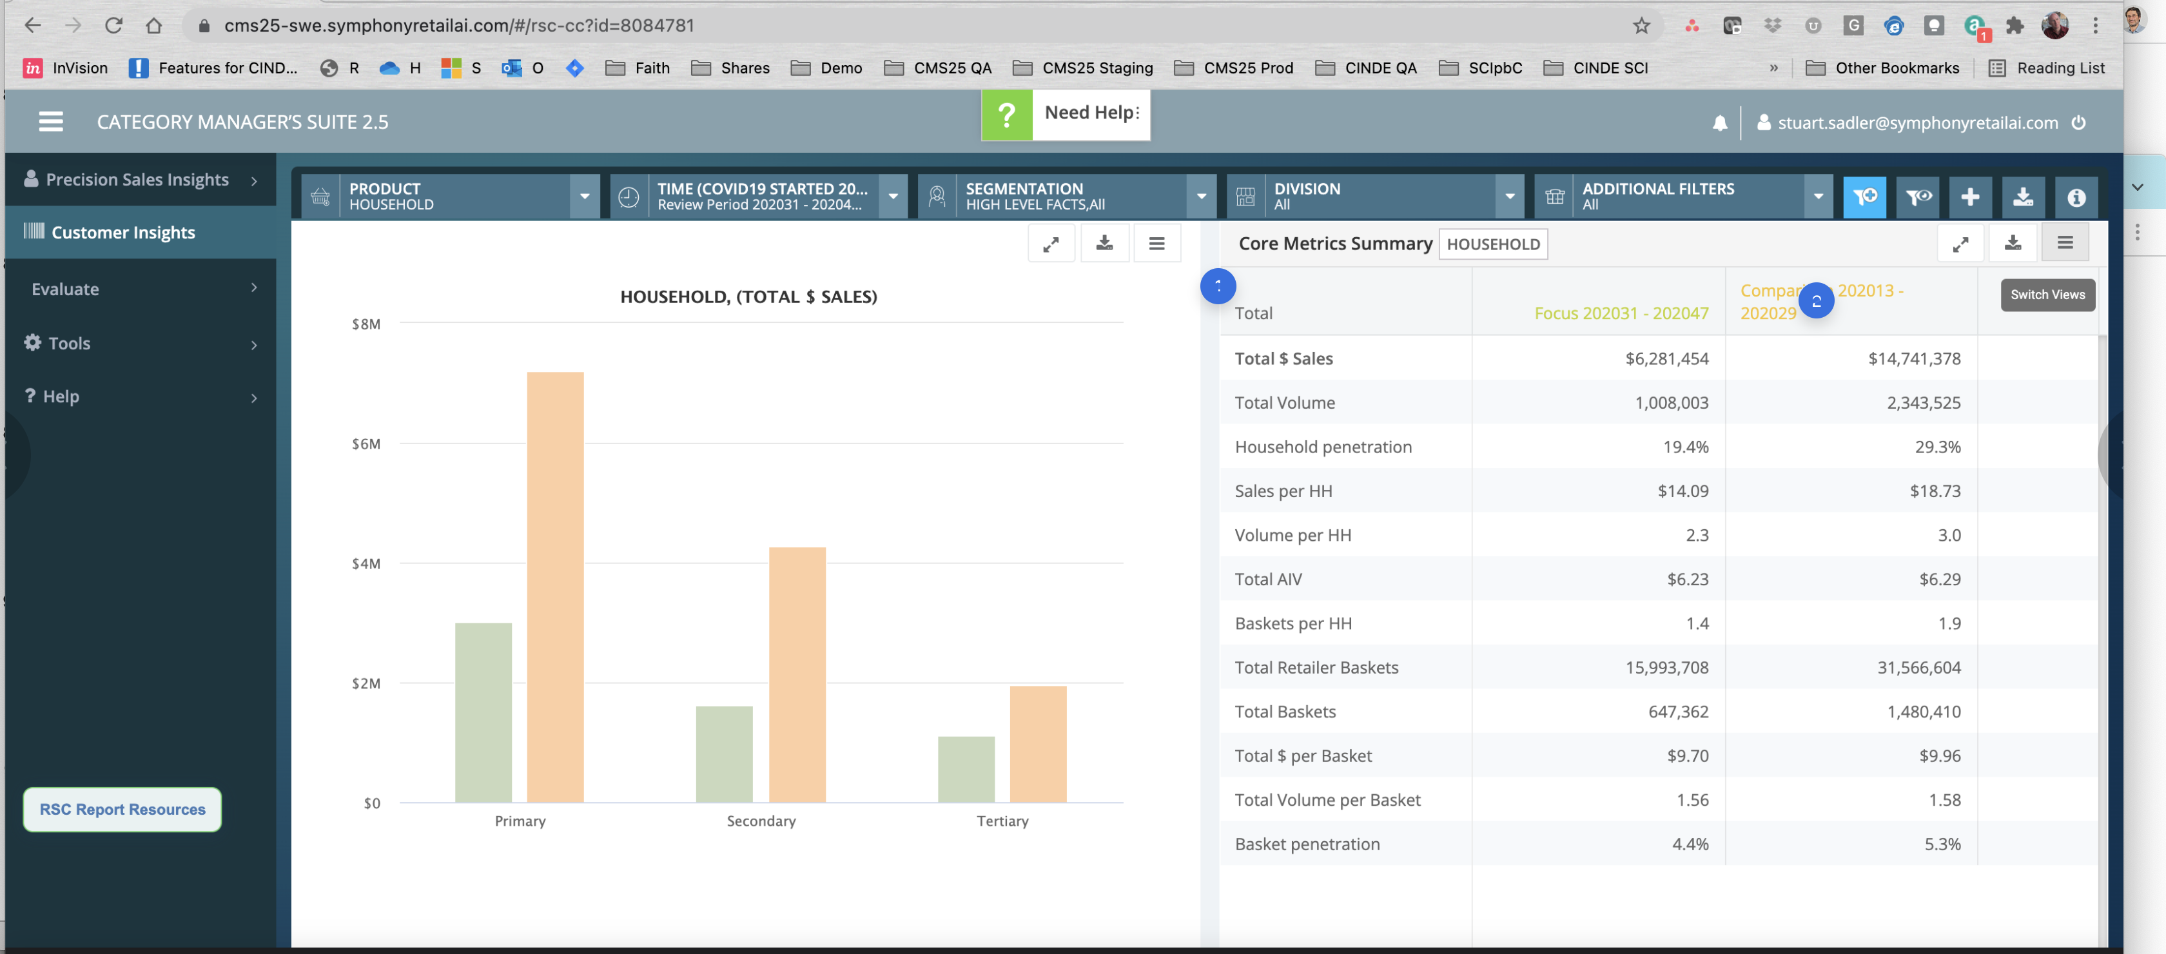

Slide 92
this looks like yet another team worked on this gui, however, I do like the side by side layout IF and when it makes sense to separate the table and plots (I still think many of these pages could be consolidated into tables that have the plots inside them or into dashboards with multiple plots etc. Flexbox/CSS likely makes sense here in some cases, particularly if the column count can grow larger.
i might suggest the comparison be RELATIVE VALUES to the FOCUS. not absolute. Way too much mental math is otherwise required.

Slide 93
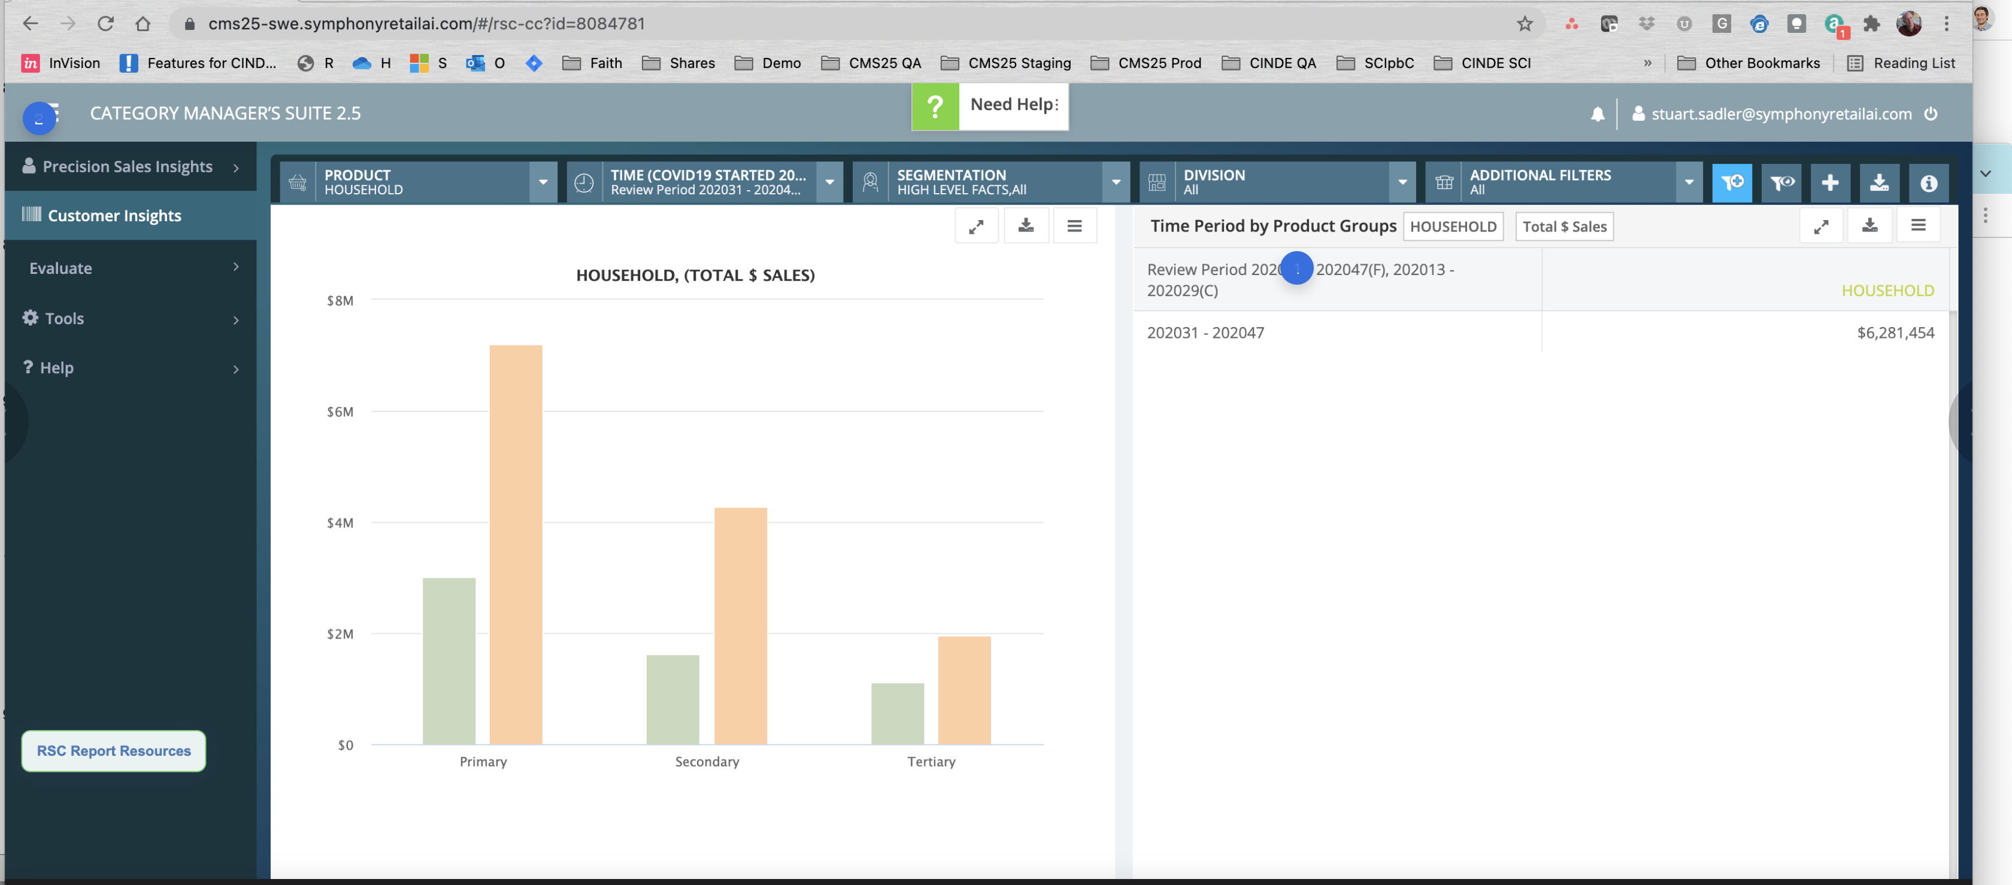

Slide 94
very hard to read the date comparisons here; awkward layout; might be something worth visualizing on a timeline - imagine 1 gray line for year 1 , on top of a gray line for year 2. then color in the portion of the line represented by the TIME selection. this is particularly true if people typically compare similar periods like xmas/december in year 1 vs year 2. the visual helps me see that i'm looking at the right portion of the timeline in both years without reading this date format.
forgot to mention this, but re: the nav here, if this hamburger controls the exposed left panel here, you may be able to remove this. i imagine most of your users are on desktop, high-res screens with plenty of real-estate that there is little need to collapse the left panel menu. you can conditionally show the control on smaller viewports but i'm kinda doubting there is a lot of use of mobile with this application.

Slide 95
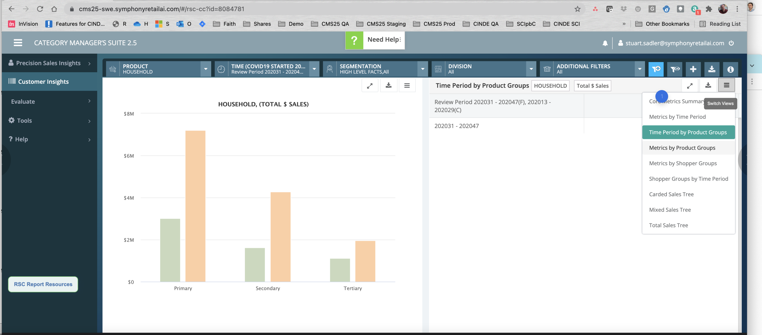

Slide 96
1) is there a reason this dropdown of "reports" is sometimes over here, and sometimes over on the left side of the page? 2) pretty sure this list could be consolidated and reduced into fewer views

Slide 97
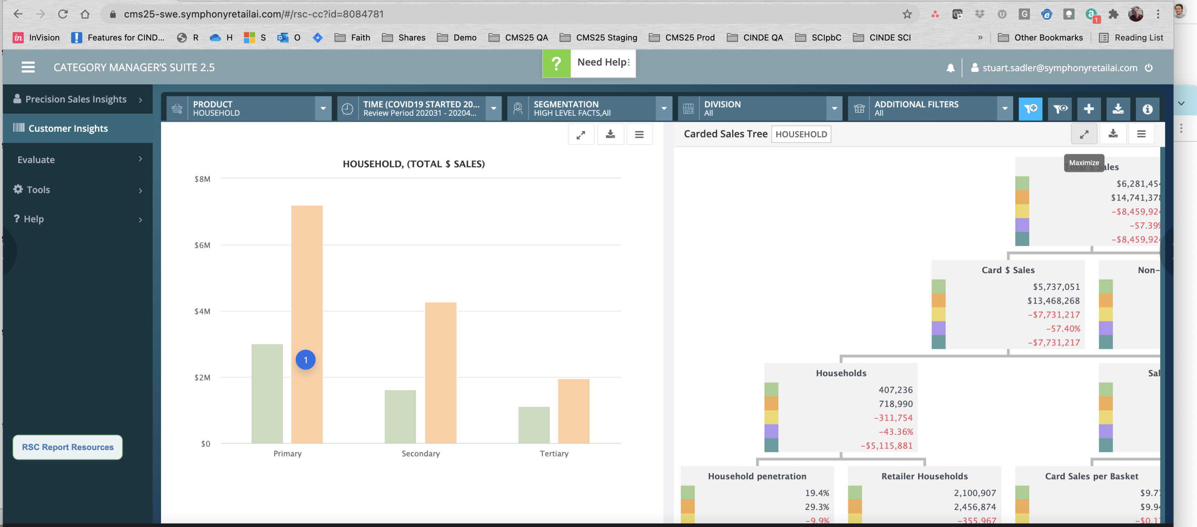

Slide 98
For this "focus/comparison" design pattern, consider playing around with 1 color, but differnt saturations. so you might leave green here, but reduce the opacity of the comparison plot by 50% to ghost it out. Less ink, and we remove some extra noise in the form of a color change that may not be necessary. the bar sizes could also be reduced; make the focus the visual focus and reduce the size of the comparison.

Slide 99
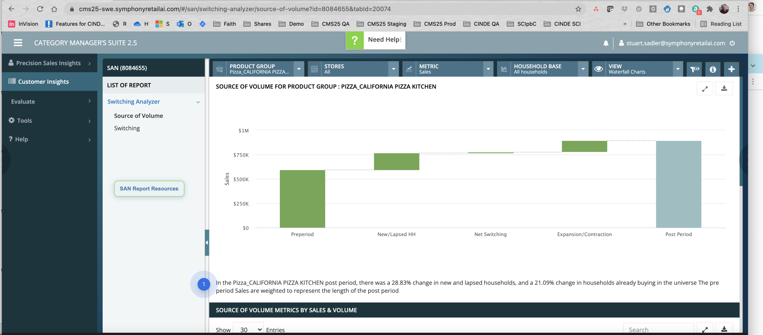

Slide 100
Again, some good things with this "conclusion." Problem is: 1) it is buried 2) it looks sloppy (mixed capitals in odd places) - this can work against the product's conveyance of trust/sturdiness 3) line lengths should always be controlled - never flow sentence copy to 100% browser width. Probably somewhere around 36em max-width, but it depends on the line height , type choices, and what's around it too

Slide 101
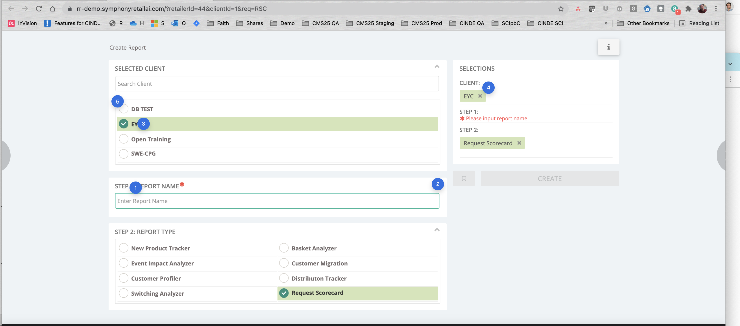

Slide 102
Consider moving this to the end, and prepopulating this with something logical based on the queries they have used. It's not part of the user's goal to create a report name, and they may end up having to stall their workflow to come up with something that works. You may want to consider giving guidance on how to name reports well, what not to include, etc.
why do i need to collapse/hide these? IDK - feels like unnecessary UI stuff; I can see this being necessary later if you decide to fold up the completed areas because this is an accordion style UI, but I might not show these until further into the process when there's actually a reason to show them.
Brian O'NeillDec 3, 2021 at 4:41 PM
I take this back; I'd probably leave these in given what I know now - primarily so that when focusing / scrolling to a particular area using the Preview Pane at right, you can collapse all the other areas.
Don't use bold for the options - roman type; if you want to bold the selected option, that's cool. probably don't need the background striping - too loud. This is a general recommendation for the GUI. If you really like it, knock back the saturation significantly - it's way too loud currently.
This might feel better named "PREVIEW" or something like that. I would also likely not have made this editable here, although I could see allowing these to be clickable to bring focus to the current section / step being edited. Need to be careful of awkward interaction design experience here where by clicking things here could be affecting things that are off page or not obvious (i.e. something way down the page that doesn't draw the user's attention). The safe bet is probably to just make it read-only until it can be tested for usability.
Don't use radio-button-styled elements as Checkboxes. Keep these square in shape so there is no confusion about how they work. This is a generic best practice; and it ensures if you have non-multi-select radio options in a fieldset, they won't be confused or require interpretation.

Slide 103
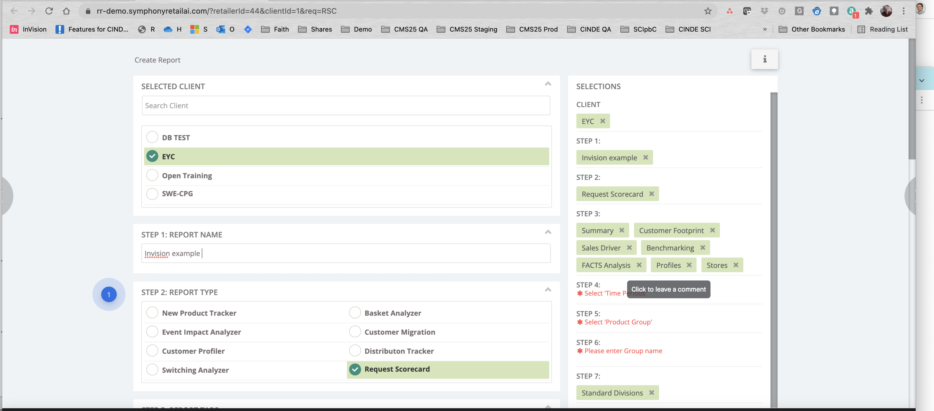

Slide 104
report types + report trackers. Candidly, these all kinda seem "similar" at a glance; "what's the difference? where do I find what?" This might be a good place in the short term to show pictures of these reports or explain what kinds of things (biz questions) can be answered by each. I understand why this is like this, but there is a real burden on the user to understand "where do I have to go to answer my task/biz question?"

Slide 105


Slide 106
General comment: if selecting "everything" has taxes on the UX such as "increased load time / latency" , then you might want to guide the user as they are picking things here - or warn them when choices are going to result in very slow reports - until you can fix your performance issues.

Slide 107


Slide 108
I assume this is using CSS position:fixed which makes sense to me when mid-page although I would remove this (i) icon (perhaps down into top right corner of box). generally, I try to avoid multiple scrolling elements inside a single viewport; this may be ok - it has the value of keeping the CREATE button visible. Another option that may work better is 1) remove the fixed box height so it does not use overflow 2) when the height is larger than the viewport high, move the call to action (CREATE) into a full width bar with background fill color, pegged (position:fixed) at the bottom of the browser window. 3) then if necessary, add some light shadowing/styling to show that content such as the Editor and Preview Pane are "flowing underneath" (z-index layering) the call to action bar. This helps reinforce to users "there is some hidden content under here" and keeps the whole UI limited to a single scrolling panel.

Slide 109


Slide 110
I think this was mentioned earlier, but in general, I would think certain types of products are used repeatedly by certain users. as such, wherever possible, don't treat users as if they're starting with a blank slate. "recent groups" or "common categories" -- things like this should likely be used to accelerate the tax of forming logical groups. There may not be a lot that can be done here, and it would be interesting to look at common group sizes and to see how users do this action - it's a lot of setup/tooling work and could be ways to optimize it.
unclear what "all" refers to. nor "show all" - a label seems missing and also not clear which UI panel this relates to.
A little concerned about the complexity of Editing/Building a large system object here (Report) and then giving them an exit to manage a sub-system object (Product Group) and the ramifications of that. For example, if I hve (3) previously defined groups Digiorno, Stouffers and Tombstone, and I choose to "edit" one of these, what does that mean for all the other reports using that group? This is not necessarily wrong that you allow editing here, but if that is a multi step process, and we can end up "losing" our incomplete report here, that could be concerning. Another idea is to move this step much earlier in the process - so they dont get through 6 steps only to realize they have this extra work to do that is not simple and has ramification elsewhere.
General visual design comments: Too many different greens TOO MUCH ALL CAPS TEXT Too many font variations (weight, color, size, caps) Too many variations in UI elements such as buttons (rounded, not rounded, shadowed, not shadowed, colored, not colored, etc) Fieldset striping/boxing probably not needed or could be reduced (opacity and/or quantity)

Slide 111


Slide 112
its a little this refers to values that could be hidden or are off-page ("group 5") . May want to dynamically print the selected values under this field labels. Parenthetical can probably be reduced to just "Max: 25 chars."
Same caveat about domain knowledge as before with this one, but: As a user, I dont know what a Product Universe is vs a group - I think this system object/model needs to be explained. I imagine most users would not understand this presented like this without explanation. I am guessing this means a superset group that is not as big as the entire catalog, something like "all food products excluding non-edibles." With the idea that whenever I am doing comparisons, if I'm managing frozen dinner category, the largest group I would ever compare to is 'all food products' but not cleaning supplies, kitchen tools, floral dept, etc. Just a guess.

Slide 113


Slide 114
I would think stores imply Geography and logical groupings but not sure. As such, a list UI like this probably would make it hard to make sure you capture "all stores in region X" . Not sure if that is a valid use case but I thought these businesses often were managed at regional levels and this UI doesn't seem to support that.
With these list style UIs, I'm concerned a little that the selections are buried in a very long list and aren't being shown "near" this UI element. The issue having them at right is that the Step 7 section could be "off page" given the current page UI design choices. Even if it is "on page" in the viewport, it's a strange eye jump to have to look across the page to the preview pane to understand what is chosen here. I would likely print those green tabs being used in the preview pane above the search Stores UI box so the list of selections can be easily seen. This is probably a generically good pattern for any lists that require scrolling due to their length.

Slide 115


Slide 116
As stated earlier with the Date picker, this also feels like something that should be handled on the "view" not the "build" side of reports.

Slide 117


Slide 118
I dont know what this means. Is this about roles/permissions ? If so: "Share with:" "Grant access to:" Things like that may work better. I would also recommend printing text that explains what will happen. Will they be auto emailed ? because you're dealing with email addresses, it suggests that email may b e sent - so i would explain what will happen even if the answer is "they will not be emailed, however they will access to this report at their next login." ANother idea, is it possible people want to select "all users belonging to domain X" where X is something like albertsons.com ? Finally, this also seems like something that users may want to do "later" once a report has been properly built , viewed, and solidified. it would shorten this process as well. if you cant remove it here, consider collapsing this and making it "skippable" by default instead of open/inviting by default.
EL

Slide 119


Slide 120
Scheduling - I am on the fence about whether this is also something that belongs later in the UX, after the Build portion is done. That said, I don't think it's clear with this label what this means. Might try: "Email this report on a regular schedule:" ( • ) Off ( ) Set schedule.... This immediately made me wonder "who will get this?" everyone in the prior Users list? If so, that should be clarified (I can imagine there are people who only want View access but dont want to get this in their inbox on a schedule) .
EL
unclear what MEX is - not in prototype.

Slide 121


Slide 122
This dialog was unexpected. I dont know what the warning is and on top of that, the UI is colored "green" which in some cultures connotes "success/Ok." If "100% data sample" means "really really slow" then you should say that here in plain english, and provide a way for them to adjust the sample size. I would give some idea of the time difference involved with sampling rates so they can make an informed decision. Finally, the "schedule date" UI was unexpected. I assumed i was setting this report to run a schedule regularly, not ONE TIME on a specific date. Why a user would NOT want to do this RIGHT NOW is beyond me. It's also not clear if I am looking at a page with "1 form option" to choose from (10.26) or whether a screen state is missing in invision, and this is the "10/26 was selected" state. The current gray bar does not look selectable and having everything with background fill is confusing -- 4 different colored stripes here.
remove this from all dialog UIs; let the top right corner handle this. i would make the positive affordance (Checkmark button) larger width-wise too.

Slide 123


Slide 124
This is not what I expected as the final screen. I expected to see something that resembled my report. Why not just take them to Report Requests screen if that is a screen showing pending reports? You can then flash the success message at the top of that screen. Just be sure the report they just made appears very clearly (i.e. top row of a table grid/list of reports) and some sort of status indicator. At least in your current implementation, that's the rec. ultimately, somebody would probably like to begin looking at their data, even if only partial. I expected to get some sort of dashboard like scorecard UI or something here when I hit create. Also, you MAY want to have a preview button on the previous screen - but only if there are ramifications for submitting the final report to the system (i.e. it is locked and you cannot edit/fix mistakes until it runs the first time or something like that). if it is easy to recover from mistakes, no need. This also may be the place where I would introduce access rights , sharing, and scheduling features - after the report has been built. Even more true if this gives the chance for the system to work in the background while the user is doing other work/making progress. We want to minimize the chance they go to the Report Requests screen and see "pending" or "incomplete" or some odd state like that due to latency issues.
Language: Request, Tracker, Scorecard - lots of terms to keep track of. I expected the next page to be called "report requests" but it doesn't have a Title on it, and it's not called "report requests." I would want this button - if you're leaving this UI in place which I don't agree with - to clarify where it will take them.

Slide 125


Slide 126
"solution" feels a lot like "view name" or "page name" I would like to see this as a page title in large, clear print. then you can remove the Solution column from the table.
EL
general table guidelines - probably do not need to underline text by default. use :hover state perhaps to show underline. The only exception is that if there are conflicting clicks/destinations and a chance the user could go to the wrong place. in this case, underlining "the one we want to quietly drive them to" is wise. Also, I suggested removing the Solution col; if you leave it, I would consider removing the hyperlink if it is the same as the Report ID and Report Name. I would just link ONE thing to the unique Report instance: Report Name --- and then unlink the rest so users don't have to figure out, "does this go to the same place as the ID link or the Solution link?"
this is an example where I i might use a TR background fill color to more strongly iterate that "some rows are processing" - you can then get rid of the large green status indicators which are "normal state." We can reduce the clutter of the UI by making the normal/majority state quiet and just bringing the eye-attention to the abnormal rows (Scheduled and Processing)
EL

Slide 127


Slide 128
I wouldnt change this format without talking to customers, but in general 1) it may be better to have the first sheet be Just the Data part 2) put the metadata summary in a separate worksheet 3) style this table to look like your UI if possible - partly for brand, but also because it reinforces that the data as been exported as closely as possible to the intended design. 4) copyright statement feels a little odd here, and also has wrong year
EL

Slide 129


Slide 130
Two things: 1) Until now, I didn't think about it, but does "Request" in RSC mean "Request this scorecard" or is it an adjective describing Scorecard? If it's a verb, it feels really weird since i'm also "requesting" every time I click any link in a UI 2) I love mexican food and the country, but not sure what Mexico has to do with this. MEX feels like a tool term that is not defined and would require user "learning" to understand.

Slide 131


Slide 132
I feel like I just placed my order for enchiladas and tacos successfully. All joking aside, I have no idea what I just did here "successfully." An unexpected system response to a vague input.

Slide 133


Slide 134
yet another design choice for a Dialog-closing affordance. The UI definitely feels like it was built by yet another group who did not re-use patterns that already existed. Specifically, most dialog windows dont need more than a single "x" to connote they can be closed. you dont need a button up here, nor the text "close"
EL

Slide 135


Slide 136
WOH. I feel like I just left the entire CMS application and almost feel like I am in MS Outlook from like 2005 > New Message UI or something. Am I writing an email? This is completely not expected and a jarring UX change from the previous GUI. This whole workflow is cryptic...
EL
This is not intuitive; i don't even know what I am supposedly trying to do. i like that there are steps if the process is this complicated and must be, but it's unclear what i'm doing or why.
this looks very dated and doesn't match the other form UIs in the product; I would try to rework this page to feel like the other form interfaces in the app. this seems to be the aberration from the norm..

Slide 137


Slide 138
Again, still dont know what a MEX is, but 1) if it is available to view, why isn't it attached here or linked up so I can view it? the next logical action, if this is a report, is to "view it" but i dont see a way to do that here. 2) this table looks circa 1996 ;-) Consider adding some basic styling to quiet down these heavy borders. Remove the ALL CAPS. 3) This feels like debug output from a developer IDE or something; if this is intended for very very technical users who like things this way, then ok - but it's hard to read. It's also unclear if the asterisk is functional here, or a delimiter. 4) why would you forward this email if you can't view anything from within it?

Slide 139


Slide 140
General comments: this screen seems devoid of any context of "what product groups are relevant to me right now?" This may not be the place to do it (i.e. a dashboard may be better) but the point is: I rarely need "all product groups." If I am working with a set of products , its probably for some period, and accessing those without all the noise of "all groups" is probably really relevant.
General Comments on UI: Consider removing 1) FOLDER and CREATED , LAST USED or making these columns off by default 2) Updated date may be stronger if voiced in "time ago, in words" instead of stamping the date. Clock format should match user preferences. (i.e. 12hr clock for US for example; 24 in EU etc) 3) Not sure why it is important to see Dynamic here. Might be able to put that stamp next to the # Column (Count column ) if the number of products is the thing that is indeed dynamic. 4) Without seeing real customer data sample here, i cant be sure, but it seems like some product photos here might help people rapidly find important groups (Visuals are faster than text) 5) Updated By may not be helpful without knowing what the peer updated. Without understanding the team-based use cases for groups, it is hard to comment further on whether this is valuable or what could be done here.
CSS: consider striping or bordering tables - not both. you dont need this much ink to outline rows in a table.
this feels like a "new folder" icon that is out of place (I.e. it feels like i would normally need to have some rows/items before i would want to Folder them)
First glance: "is upload and manage upload the same thing?" unclear. if they are, consider shortening the label to Upload.
Default: without knowing more of the use cases for a PG index page, my guess is that you could be showing a lot more rows before paginating. 50 or even 100.
Just noticed that this masthead area of the application changes on the PRG UI. What happened to CMS? Branding and template wrapper UI shouldn't be changing arbitrarily within the same product/app. There are sometimes functional reasons to change thing but this doesn't seem like one of those times.

Slide 141


Slide 142
CSS: this gets back to the theme of "too much non-data ink." When hovering over the dropdown options, you don't need to change as much to denote this is an affordance. Text Color, underline, and background are all changing on hover it seems. Less ink. Also, if the create new group is only a dropdown affordance consider showing a small down-carat icon next to the word Group. It's a subtle way of showing "there is more here than just Create New Group."

Slide 143


Slide 144
Idea: Could this be logically created with data AFTER the group is populated, and particularly if the user isn't sure what to call the group? I dont know how many groups users are dealing with at any one time, but I would also be doing #research to understand this - it may help inform foldering, grouping, naming, duplicate+reuse actions, etc
Clipboard? This sounds weird to me - I imagine most users wouldn't understand this label.
SS
Stuart SadlerNov 17, 2021 at 1:56 PM
think this is ok. what would be better?
Brian O'NeillNov 17, 2021 at 2:03 PM
Conceptually, I don't understand what this even is in the CMS context - it suggests that something in CMS was copyable or cutable , which may be true, but there is likely a discovery problem with a feature like this - in other words, they have a lot of things to learn about CMS (that products can be cut or copied somewhere somehow) before they can even "add from clipboard." This is usually an OS paradigm that doesn't exist in individual SAAS applications IMHO - even if you could explain it to me, I find it suspicious and would want to see that users were both able to use it, and the value provided was significant. More options is not always better.
widen the canvas here - show me a gray area that looks "empty" (i.e. an unpopulated PRODUCTS area that needs to be populated). Right now, it looks like the page got cut off. Also, "search for products" - being what I imagine is maybe a high frequency affordance for populating groups - probably should be a search input box - not a button - showing up right under the label so users can begin adding stuff. Aspirationally: when can we logically create product groups for users such that they don't have to go through the tax of creating the group? Are there times we can auto-create groups, even if they are not perfect? i.e. removing "4" bad products from a group of 30 where 26 of the system-generated products were "correct" is a lot less work than asking a user to find and group 26 products together I would assume. I can imagine scenarios here where you want to auto-add items too (i know you have some dynamic groups so maybe that is what this does). For example, if "Coke 2" comes out, there may be people who manage groups that should automatically detect that and add it. This then becomes one of those dashboard-type or index-page type chunks of info that may be useful to tell users when they log back in. Ex: "Recent Events: Product Group 142 now includes "Coke 2" (detected on 12/12/21)

Slide 145


Slide 146
I would save he change and re-title the page like this: <H1> Pepsi Soft Drinks [edit]</h1> It shows that the draft group has been saved and that they wont lose their work. It's more sturdy than leaving these as open form fields that are "unresolved"

Slide 147


Slide 148


Slide 149
consider showing 1-2 icons max in the row, and a a dropdown with additional actions spelled out here. refresh seems like it might be logical to show. Remove View: all things being equal, i would likely hyperlink the Name column to view the Thing, which also removes the need for one more icon in this list.
I won't repeat previous comments re: table styling, best practices with date formatting, what dates to show when, etc.

Slide 150


Slide 151
General comments: this UI looks like it was created "by somebody else" --> in other words, there are inconsistencies that do not seem to have any justification. Be consistent first, but always let context win. For example, we have green labeled "dimensions" which sure seem similar to the filtering concepts in the faceted search earlier. is it necessary to use a different UI pattern here? if so, it's ok- but I found myself feeling like the colors/GUI formatting etc here is "different." Even button colors/shades seem different -- without me understanding why.

Slide 152


Slide 153
I don't get this operator <> here and what this means in this context. consider spelling it out.

